Slide 1

Meaning in Structures: What lower manifold graph network embedding's tell us
CSE499B.5
Faculty: Mohammad Ashrafuzzaman Khan (Azk)
Done by:
Mahmud Elahi Akhter (1721498042)
Zahin Ahmed (1711020042)

Slide 2
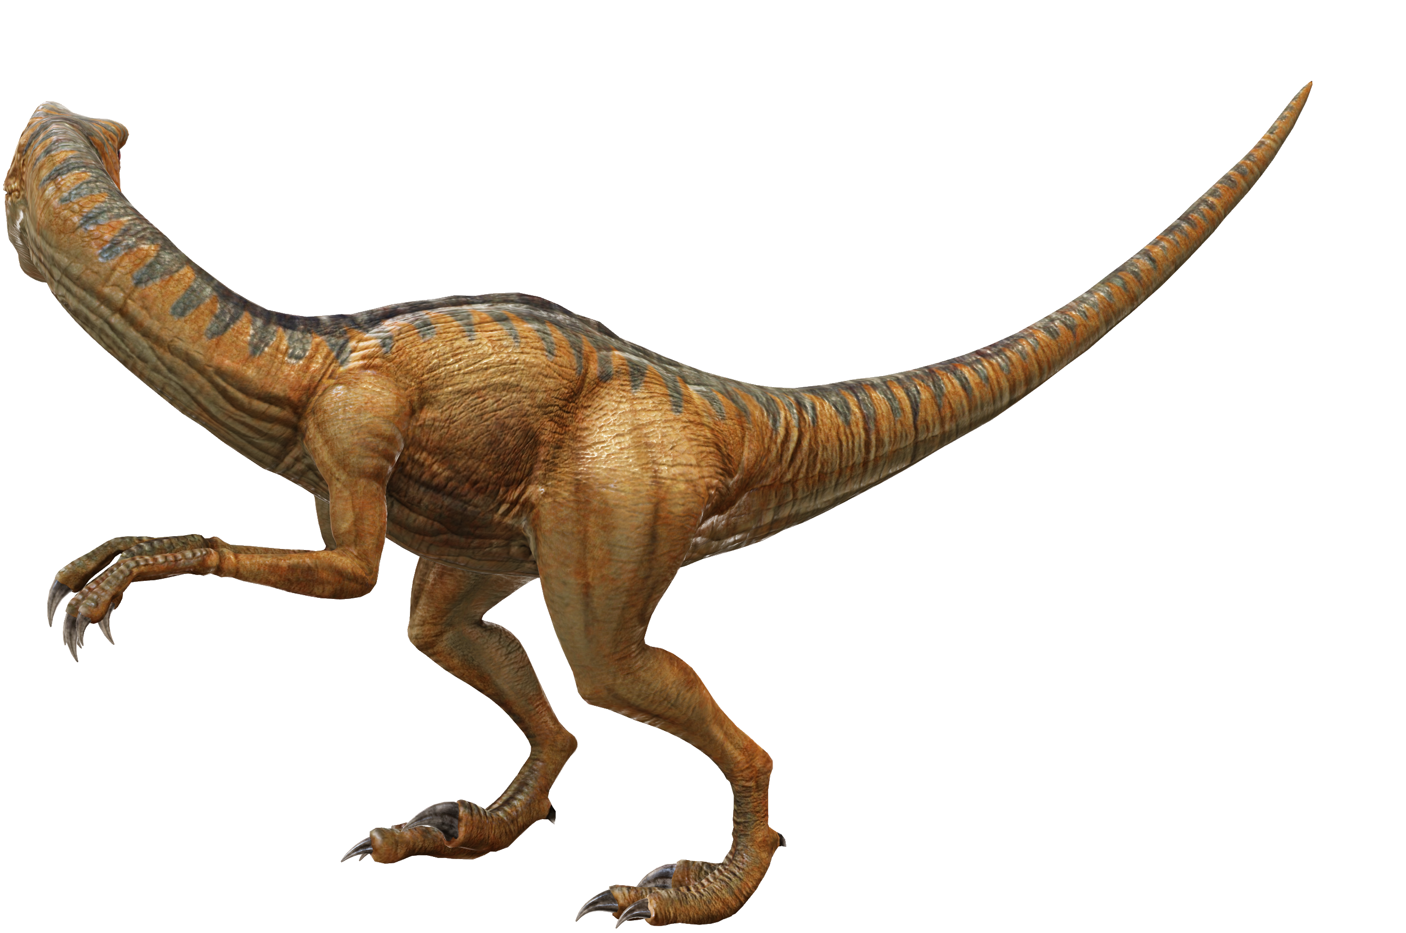
Introduction
Huge networks exist all around us
email communication
social media
e-commerce
Each network holds information regarding the behavior and characteristics of its members.
Extracting this information from known networks, might in turn help in discovering new knowledge about different networks.
Centrality values are usually used in analyzing a network

Slide 3
Hypothesis
Lower manifold representation of graph network embedding’s show structures that can reflect the characteristics of the networks. In other words, network structures are human behavior and or traffic driven. That can be represented in a hierarchical relation.
Our null hypothesis states that, networks do not have inherent structure that can give us the characteristics of said networks. For example, if a network is p2p network then it has a very chaotic random structure which we can not interpret back to p2p.
Our alternative hypothesis states that, there are structures or patterns associated to networks and it preserves network characteristics that can be represented in hierarchical form. For example, if we have email network which falls under communication class, then it will have hierarchical relation with other networks in different class like citation/collaboration.

Slide 4
Procedure
Literature Review
Collection of usable networks (datasets)
Application of methodology to all datasets
Selection of appropriate Unsupervised learning and NLDR algorithms
Results Analysis
Selection of appropriate and calculable Centralities
Ablation Study

Slide 5
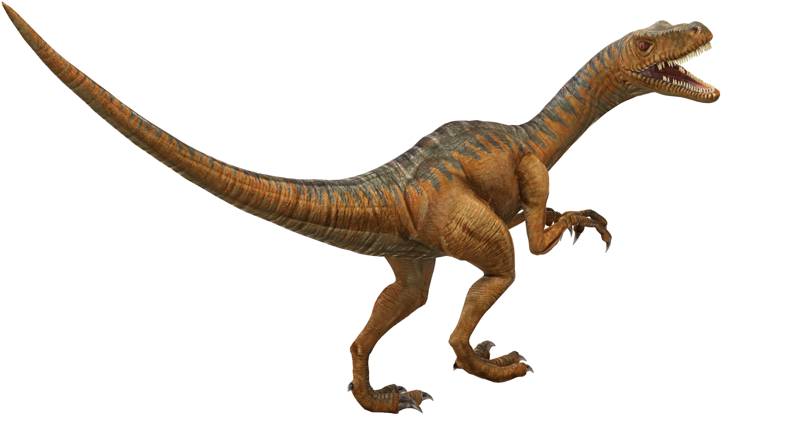
Literature Review
Over the years, network centralities have been used for many different purposes that range from traffic network to brain networks. However, there’s been very little effort to explore network discrimination through centrality measures.
In their work, Wang and Krim[1] showed that discrimination of graph networks are possible through centrality measures. They showed that degree centrality and clustering coefficients were enough to discriminate networks and adding Betweenness Centralities, Eigenvector Centralities or Closeness Centralities degraded the results. However, they only used two small sample datasets for their study.
In his study Dwyer[2] showed that visual analysis to explore and compare the centralities within a given network was possible. In the study the centralities were drawn on a 2D plane that was mapped to 3D plane. Three different methods were employed to this purpose and these were 3D parallel Coordinates-based Comparison, Orbit based comparison and hierarchy based comparison.
Sarrac´en and Rosso [3] used Betweenness centrality to automatically summarize text. In order to do so, they represented the text as an indirected weighted graph where each sentence was represented as a bag of words. They also used similarity/dissimilarity criterion to represent the semantic relation between nodes. Afterwards, a ranking algorithm was used which was based on Betweenness centrality.

Slide 6
Literature Review (cont.)
Wu[4] proposed a novel graph clustering algorithm which used Betweenness centrality recursively to create groups of clusters called LEADER which guided the algorithm to cluster the whole network.
Huang et el.[5] proposed a visual analytics method to explore urban traffic mobility patterns. They used Pagerank and Betweenness centralities to calculate the more central/ important streets. Pagerank detected hub streets and Betweenness detected street/region that acted as back-bone in urban networks.
Crucitti[6] used Closeness, Betweenness, Straightness and information centralities to capture street patterns of different cities of the world. They proposed that a hierarchichal clustering based on distribution of centrality measures are capable of distinguishing different cities to some extent.
Zhang[7] used degree, betweennesss and closeness centrality to calculate different road patterns. The aim of their study was to discriminate different road patterns using centralities. The centralities were calculated using a topological network representation of the road networks.

Slide 7
Selected Datasets
Social Networks:
Ego-Facebook
Gemsec-Facebook
Ego-Twitter
Musae-Twitch
Feather-Lastfm
Communication networks:
Email-EuAll
Email-enron
Citation networks:
Cit-HepPH
Cit-HepTH
Collaboration networks:
Ca-AstroPH
Ca-HepPH
Product co-purchase networks:
Amazon0302
Amazon0601
Internet P2P networks:
P2P-Gnutella04
P2P-Gnutella08
P2P-Gnutella24
P2P-Gnutella25
P2P-Gnutella30
P2P-Gnutella31

Slide 8
Completed Datasets:
Social Networks:
Ego-Facebook
Communication networks:
Email-EuAll
Email-enron
Citation networks:
Cit-HepPH
Cit-HepTH
Collaboration networks:
Ca-HepPH
Ca-HepTH
Internet P2P networks:
P2P-Gnutella04
P2P-Gnutella08
P2P-Gnutella24
P2P-Gnutella25
P2P-Gnutella30
P2P-Gnutella31

Slide 9
Selected Centralities
Degree centrality
Betweenness centrality
Eigenvector centrality
Closeness centrality
Page Rank centrality
Authority centrality
Hub centrality
DMNC - Density of Maximum Neighborhood Component centrality
Lobby Index centrality
Leverage centrality
Eccentricity centrality
12. Local Bridging centrality

Slide 10
Algorithms
Data Analysis:
Boxplot
Correlation matrix
Unsupervised Learning/Clustering / Non-linear dimension reduction:
Principle Component Analysis (PCA)
t-SNE
Spherical k-means clustering

Slide 11
Ablation Study
Model 1- All centralities – 12 variables
Model 2 - without degree – 11 variables
To see how degree, which signifies the connectivity of the nodes, affect the model
Model 3 – Without community centralities – 6 variables
To see how well the model performs when only centralities that are calculated globally (WITHOUT taking neighborhood/ community into account) are used
Model 4 – Without node centralities – 6 variables
To see how the model performs when global centralities are taken out of the equation and centralities that depend on neighborhood/ community are used
Model 5 - without eigenvector, pagerank, hubscore, authority – uses ranking – 8 variables
To see how the impact of “importance” amongst nodes differs from the impact of “distance” between nodes
Model 6 - without betweenness, eccentricity, closeness – uses distance – 8 variables
To see how the impact of “distance” between nodes differs from the impact of “importance” amongst nodes
Model 7- without leverage, lobby, dmnc, local bridging, eigenvector, closeness – 5 variables – mix and match
To see how more global information received about “centrality” of nodes with some community information impacts the model
Model 8- without degree, hubscore, authority, betweenness, Eccentricity, leverage– 5 variables – mix and match
To see how equal proportions of community and node importance information affects the model
Model 9- without Closeness, eigenvector, authority, hubscore, Betweenness, Leverage
To see how more information about community and some information about node importance affects the model

Slide 12
RESULTS
(Within Dataset Category,
Data Analysis)

Slide 13
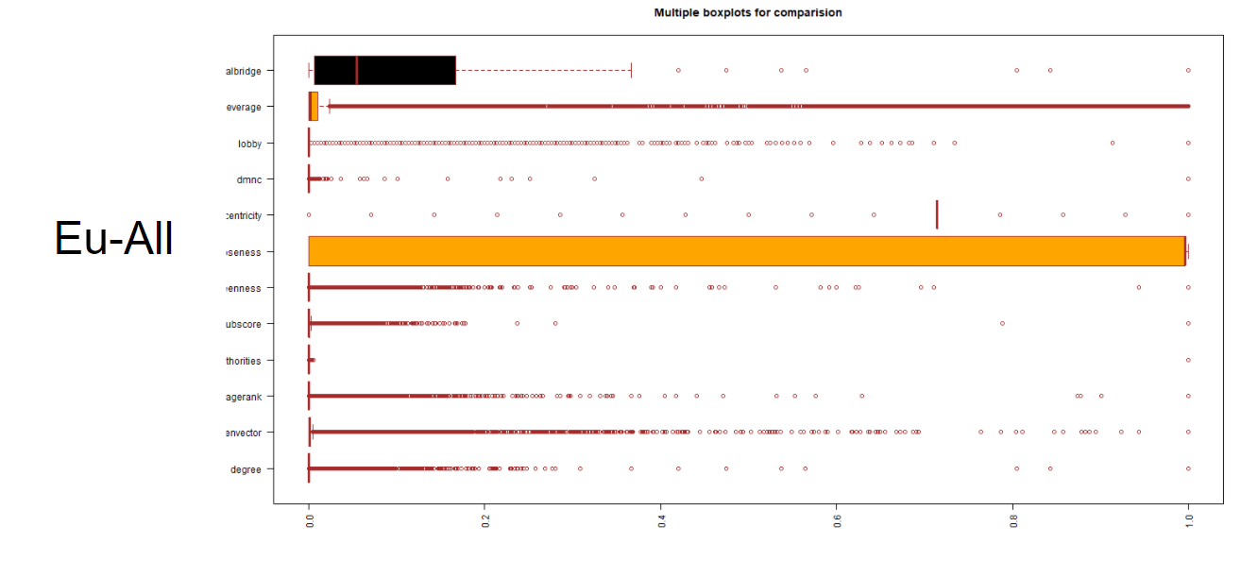
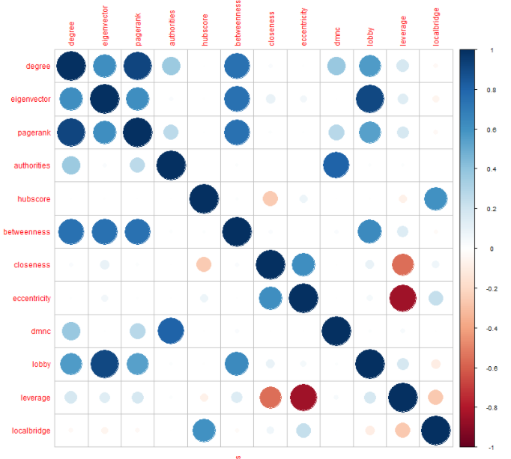
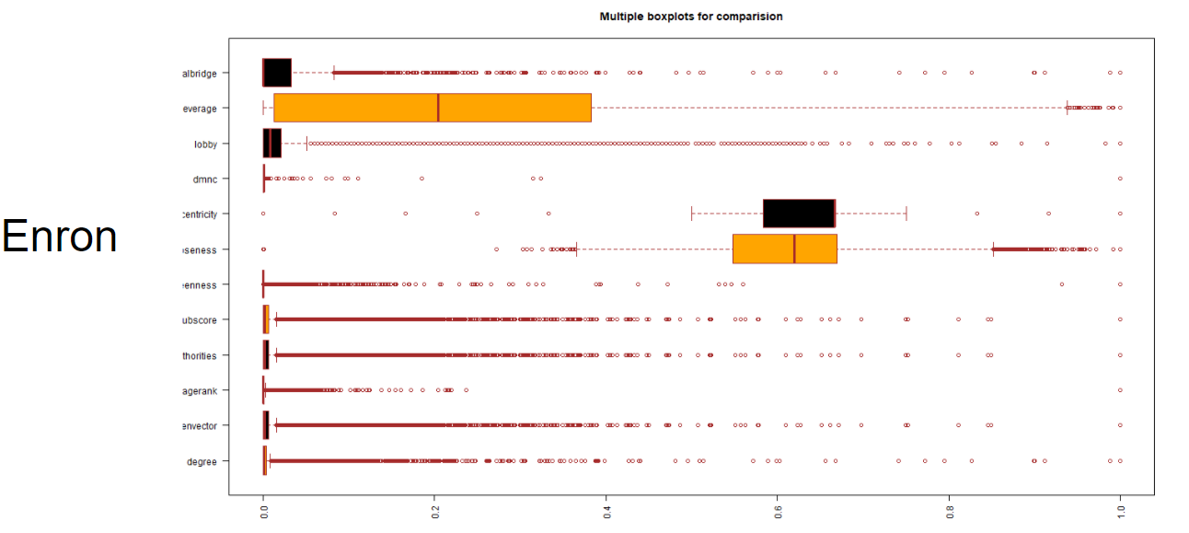
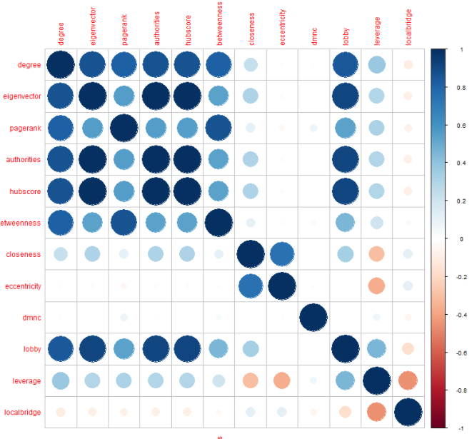
Communication Networks
Boxplots quite different
Expected since Enron is a dishonest email network
However, underlying communication network structure can be seen (Proved farther in later slides)

Slide 14
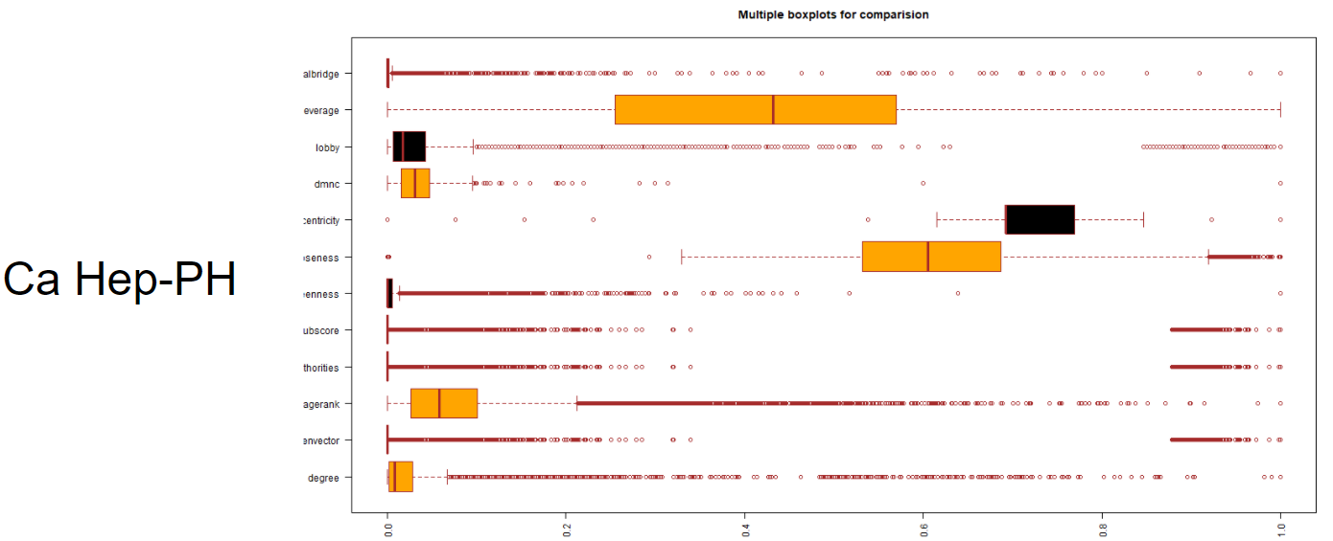
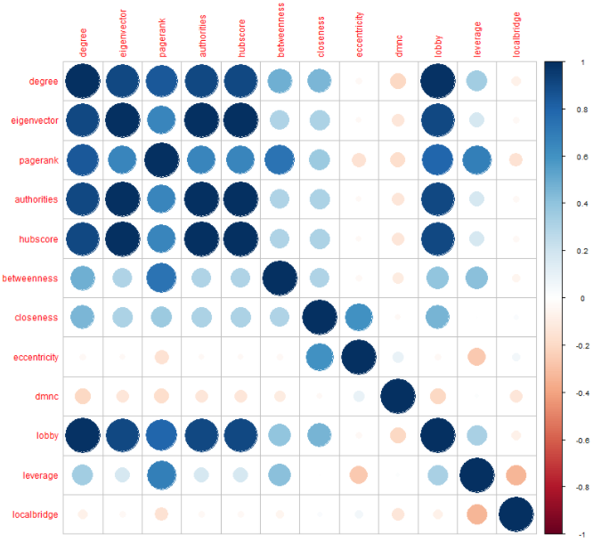
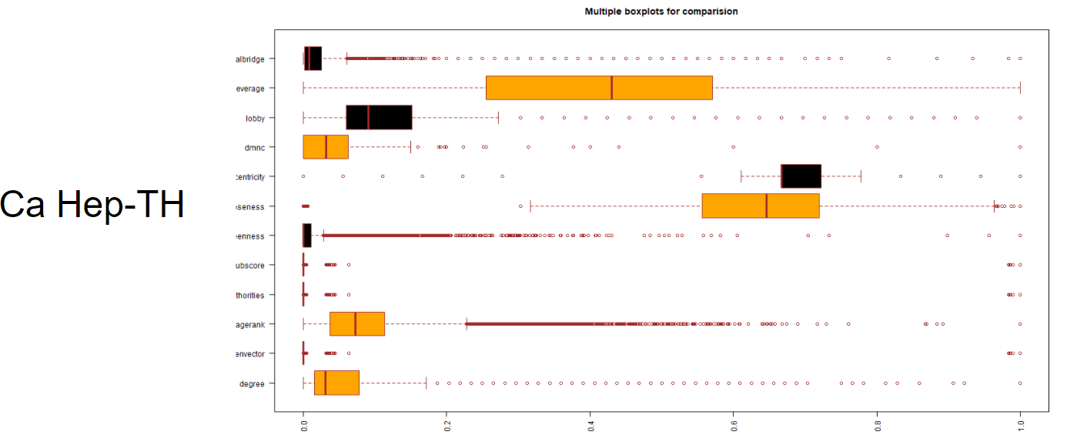
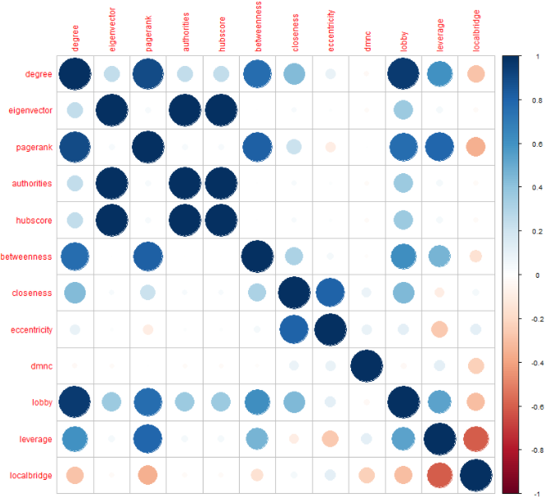
Collaboration Networks
Boxplots are similar, except lobby index
Correlation plots are quite different
Underlying Communication network structure

Slide 15
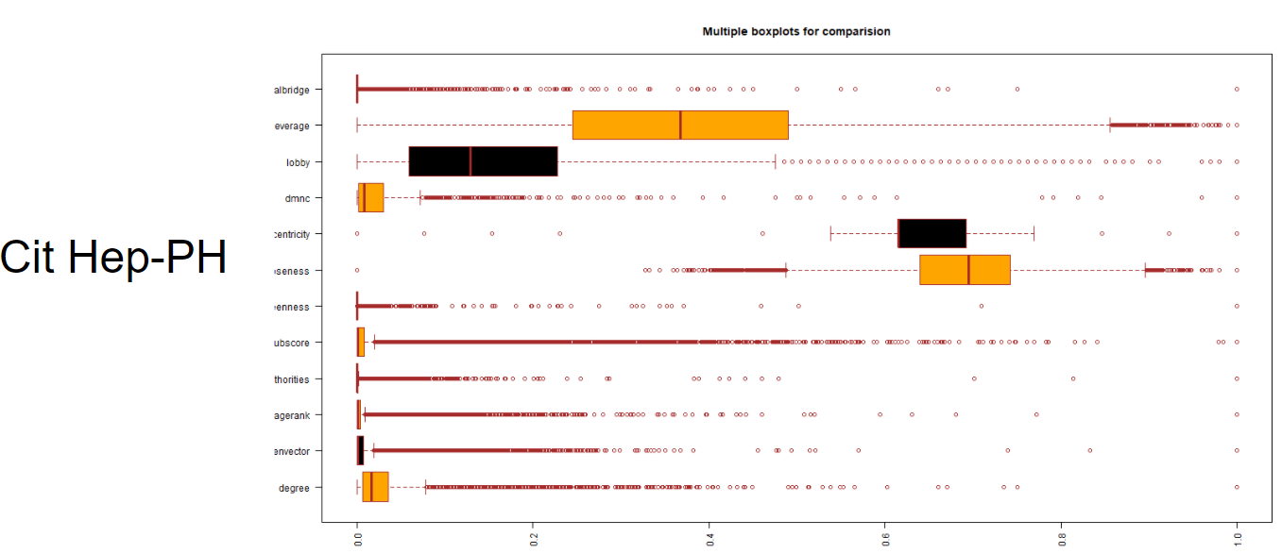
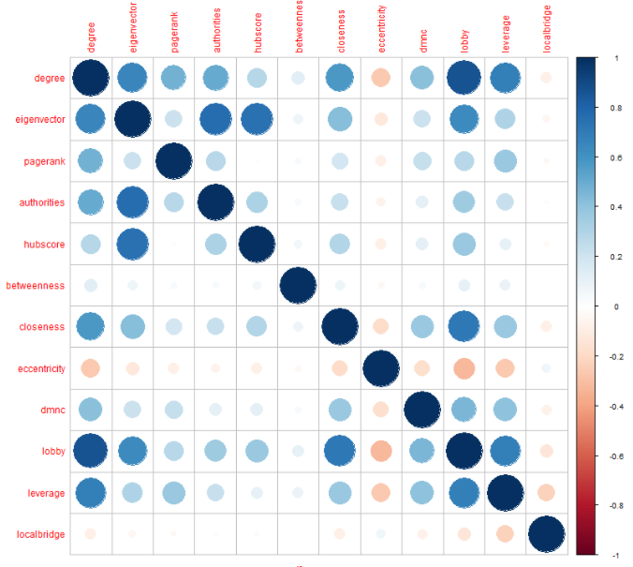
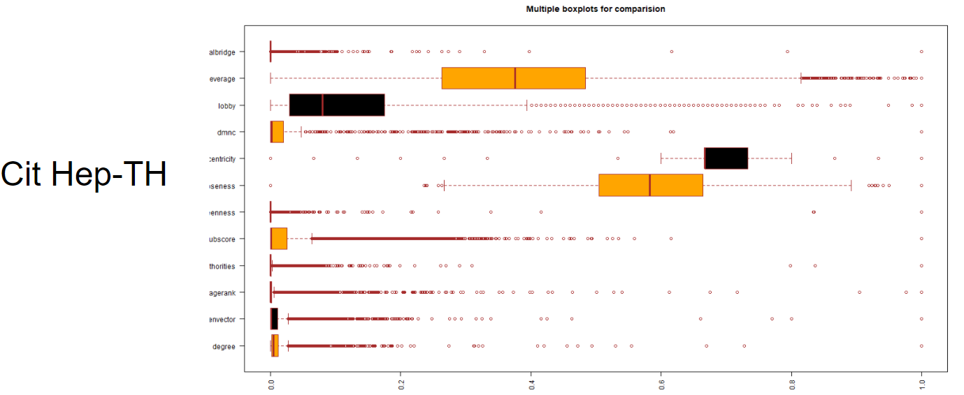
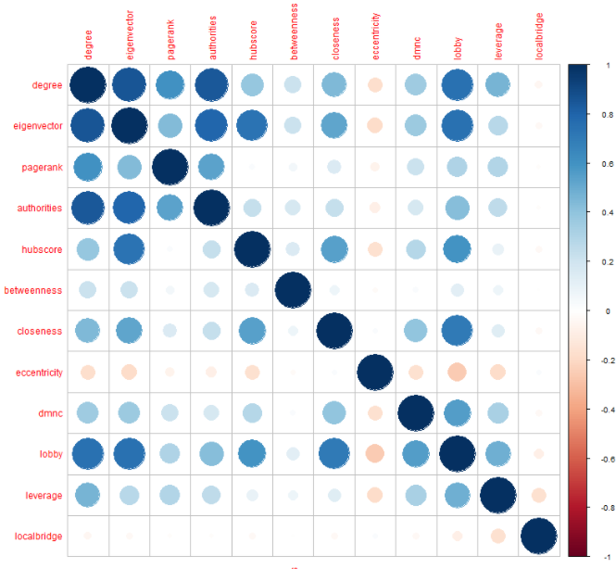
Citation Networks
Both Boxplot and Correlation plots are quite similar
Closeness is different in boxplot

Slide 16
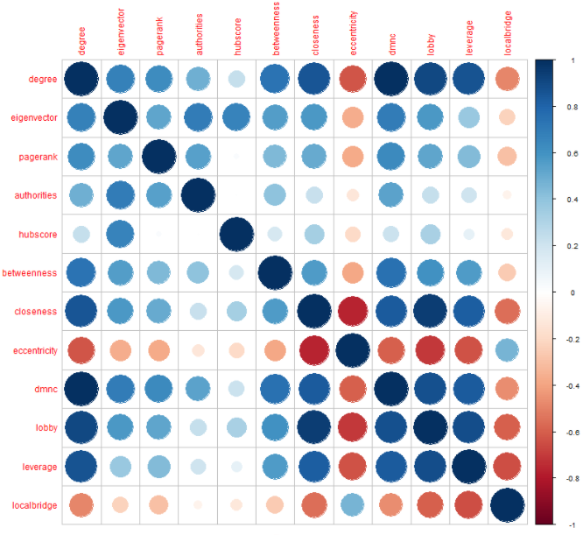
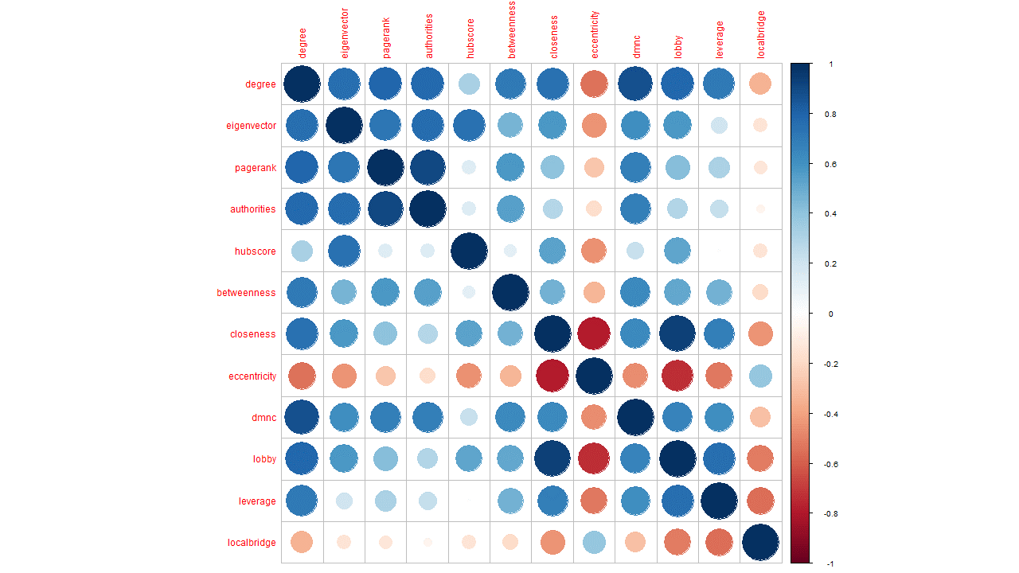
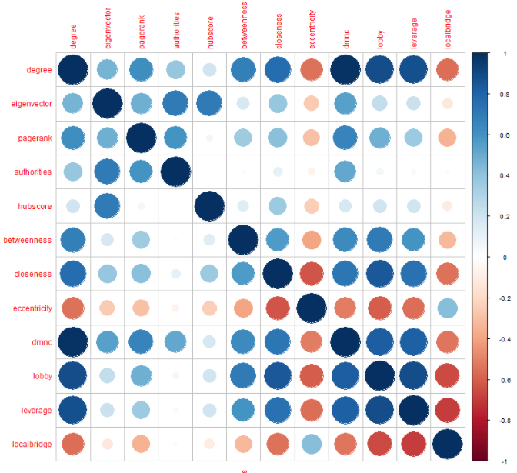
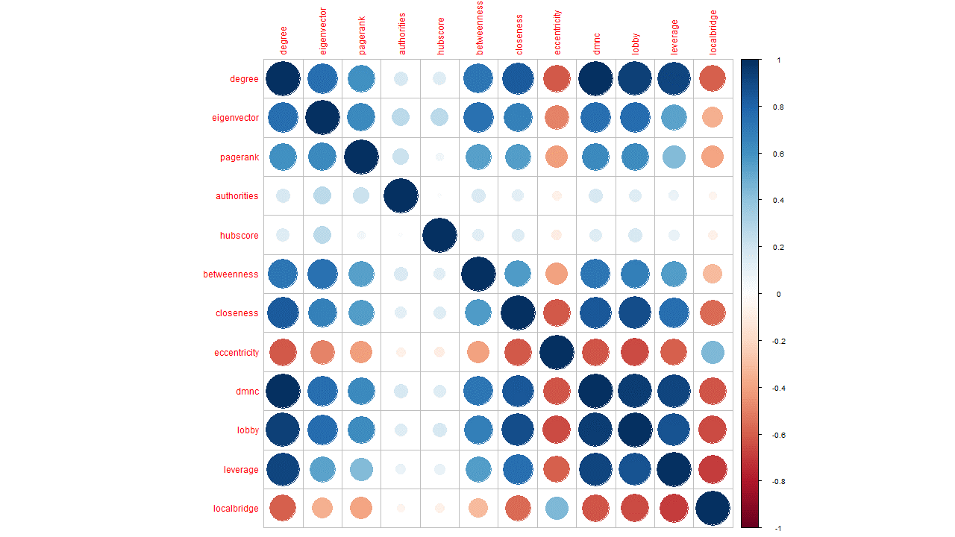
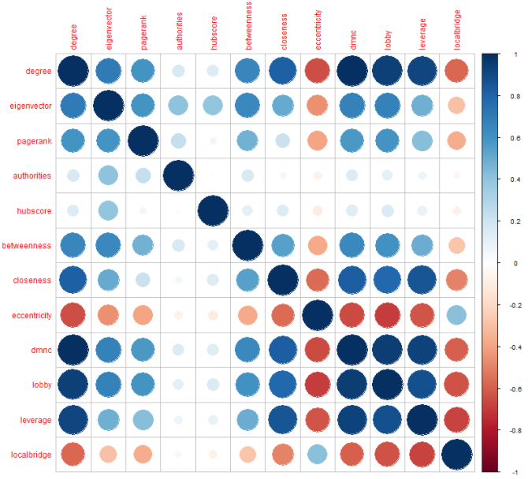
Internt P2P networks
As the P2P networks grow each day, their boxplots do not give any significant results
However, their correlation matrix seems to remain quite consistent
Aug 04
Aug 08
Aug 25
Aug 31
Aug 30

Slide 17
RESULTS
(Between Datasets Category,
Data Analysis)

Slide 18
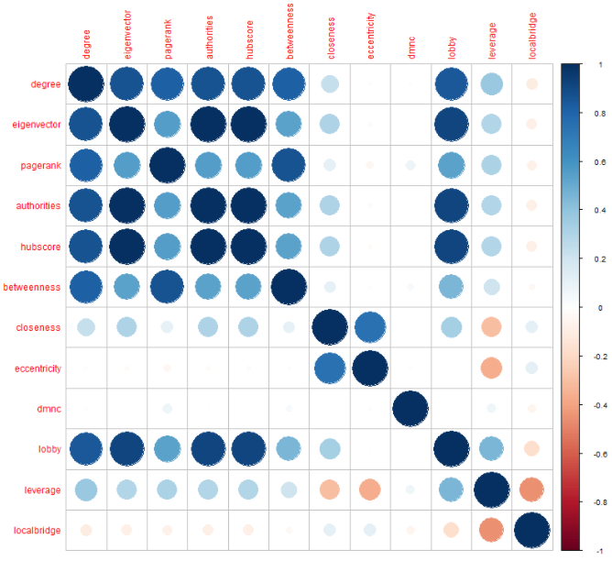
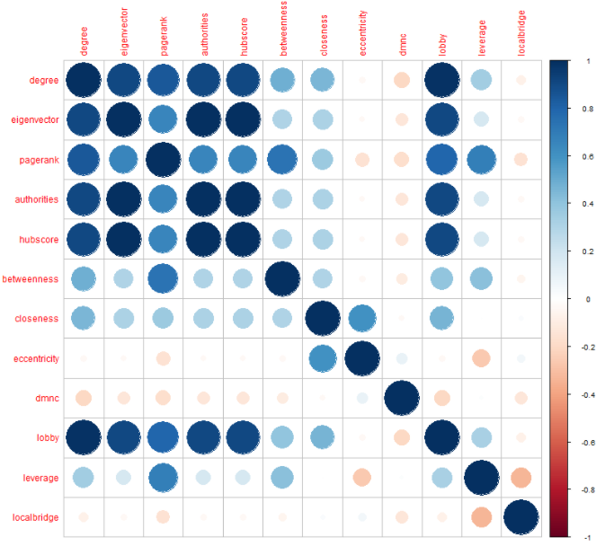
Enron (email/communication) network very similar to High energy Physics Collaboration network
Both show high positive correlation between node centralities
Logical as the influential individuals in both of these networks hold are very important in information transmission
Enron being a dishonest network (some individuals are criminal masterminds)
High energy physics is an experimental field where experts hold a lot of sway
Enron
High energy physics Collaboration

Slide 19
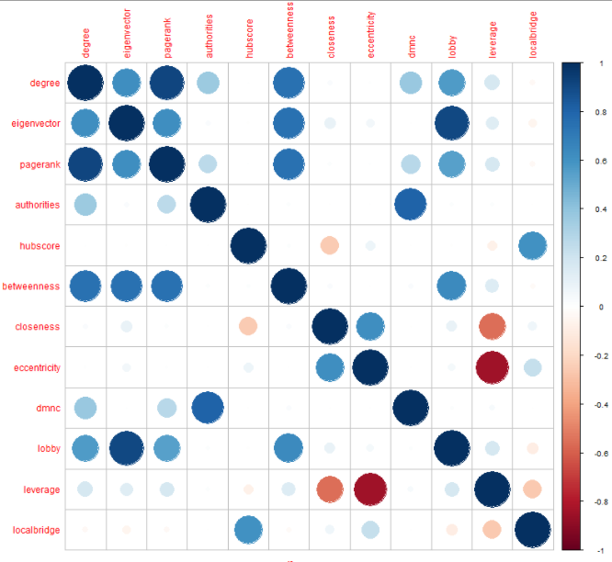
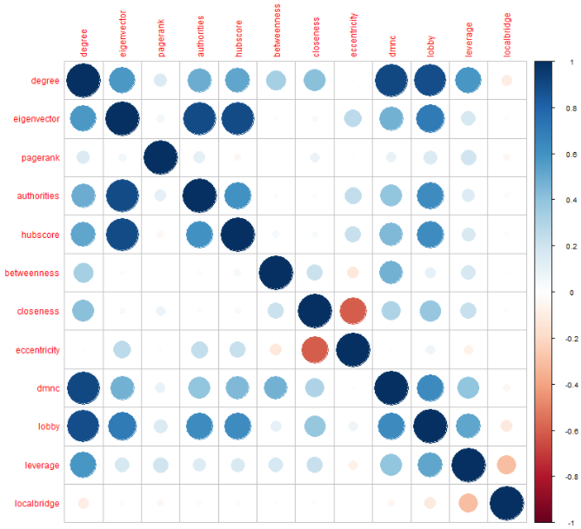
Eu-All (email, communication) and Facebook Ego network (social network) appear very similar.
Facebook Ego network
Eu-All

Slide 20
RESULTS
(t-SNE and K-means clustering)

Slide 21
August 04
Nodes: 10876 Edges: 39994
P2P Time Series
August 08
Nodes: 6300
Edges: 20776
Network growing with time
Initially more distinct clustering as small user base with specific interests
With time the distinct separation fades into a more solid structure
Diverse user base with more common interests
August 24
Nodes: 26517
Edges: 65368
August 25
Nodes: 22687 Edges: 54704
August 30
Nodes: 36682 Edges: 88328
August 31
Nodes: 62586 Edges: 147892

Slide 22
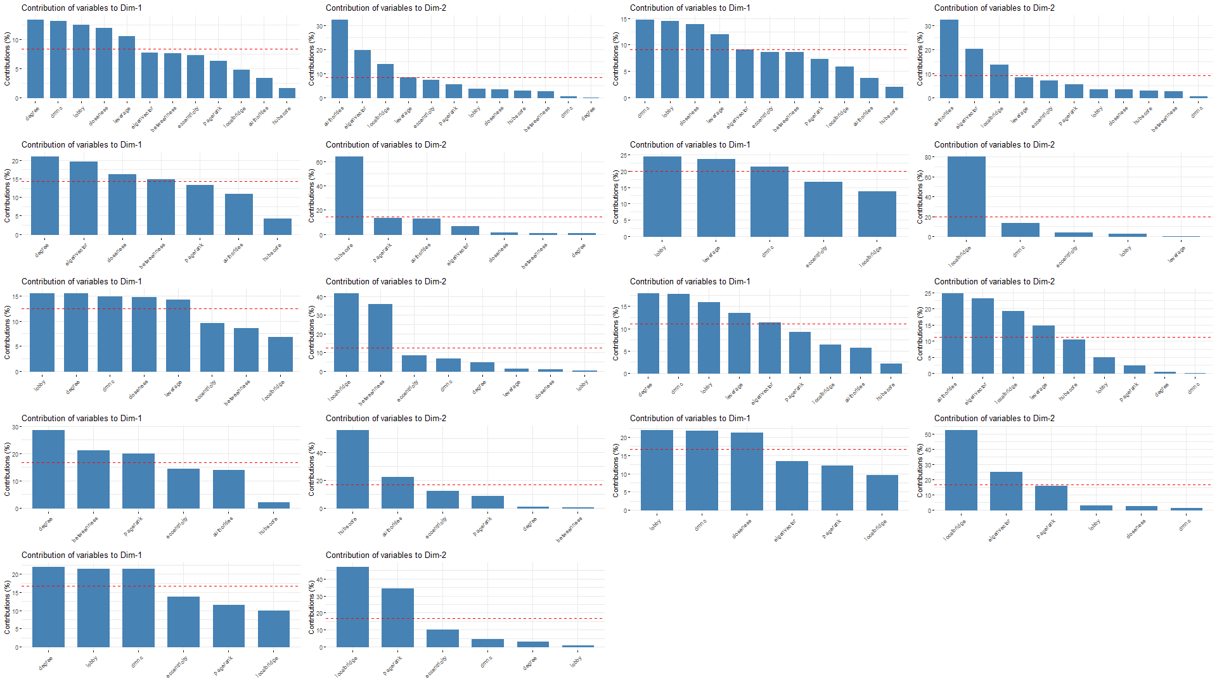
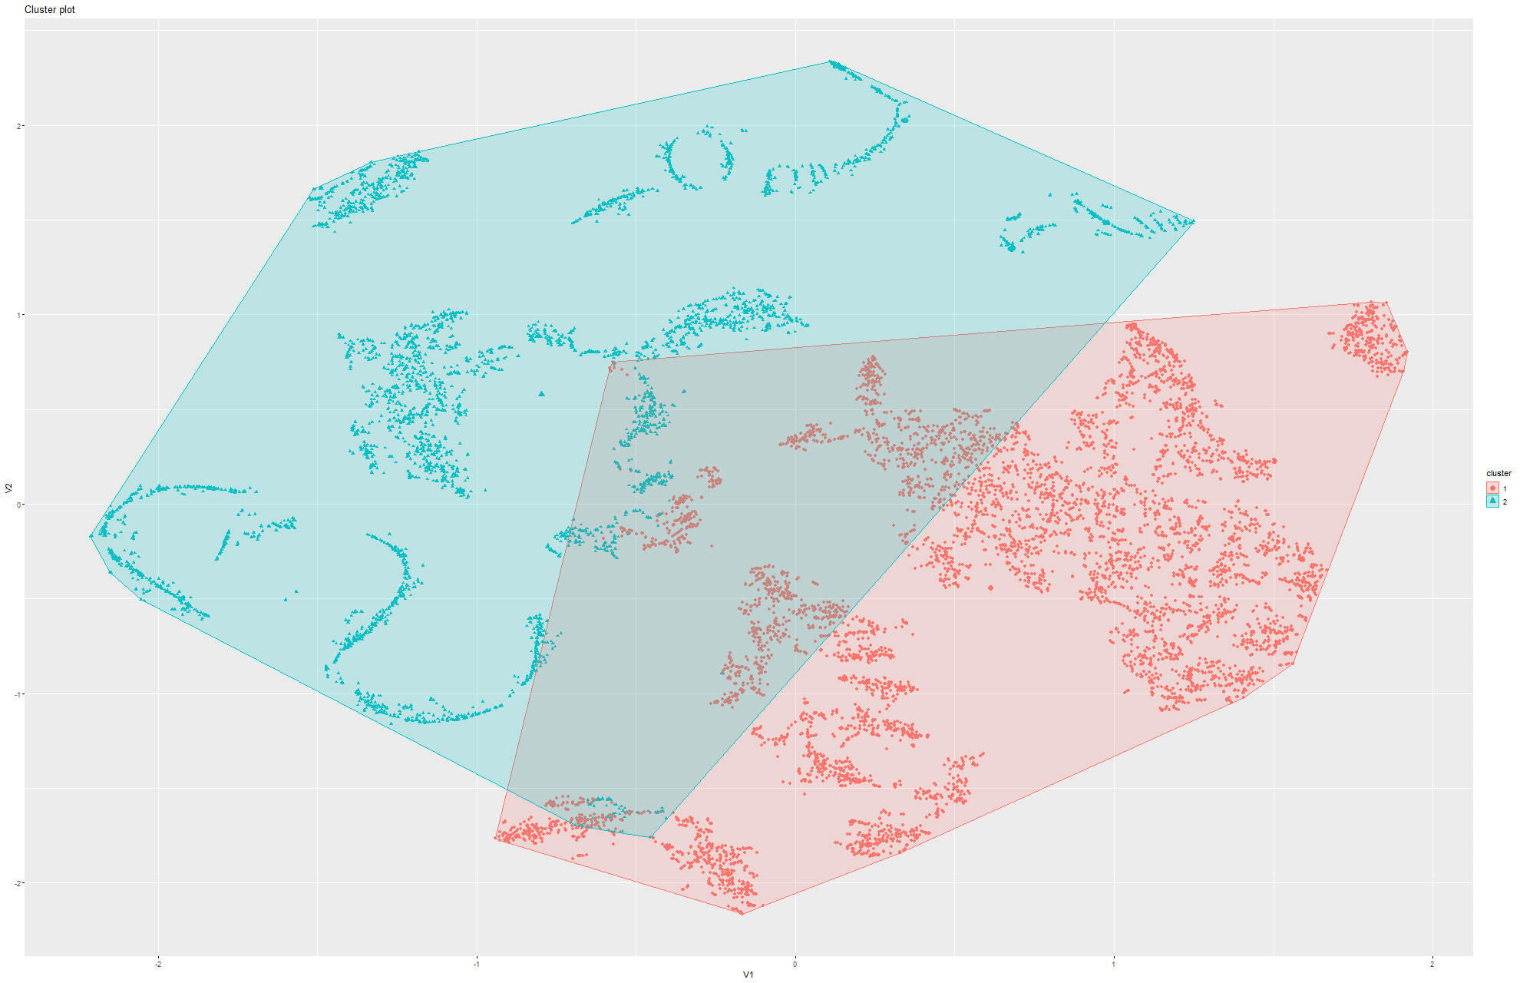
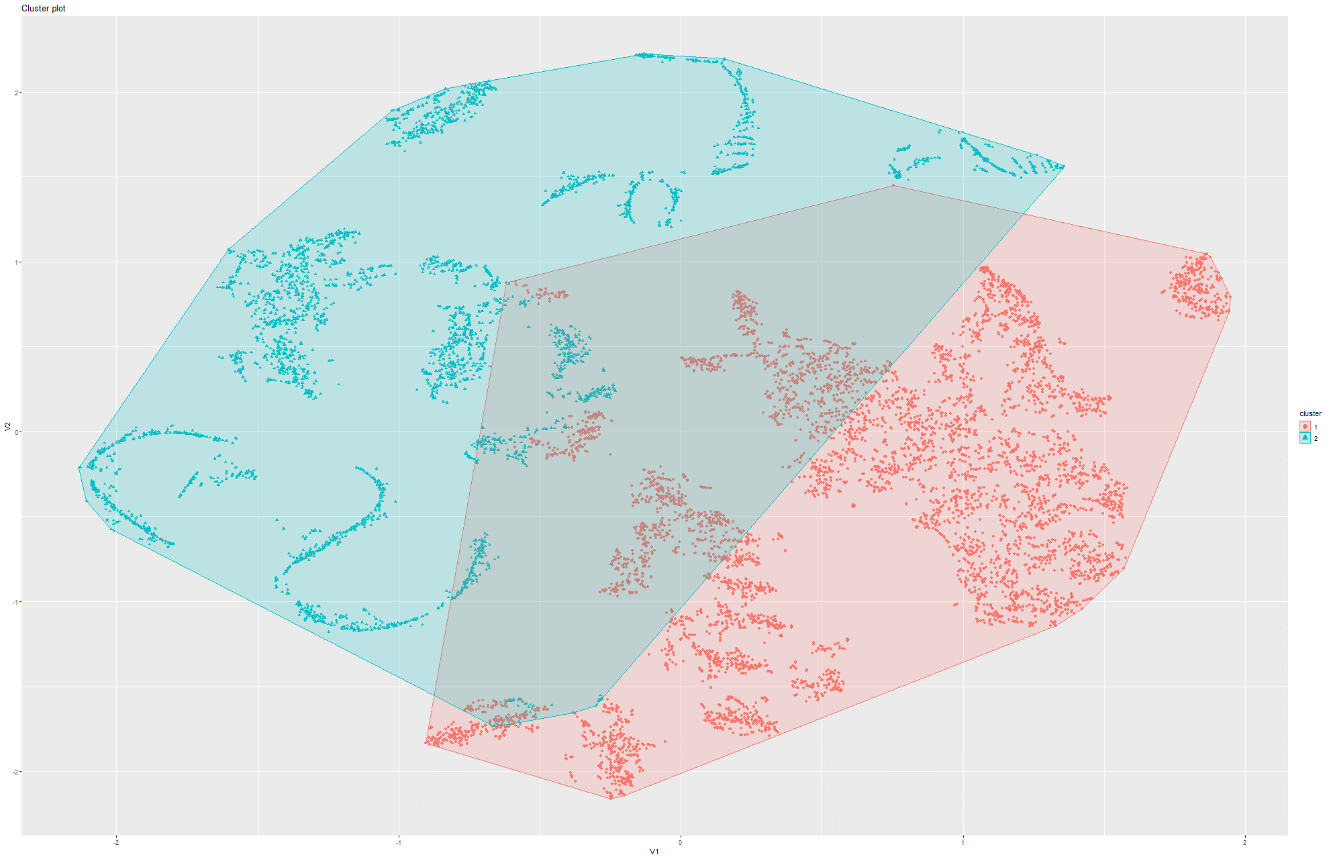
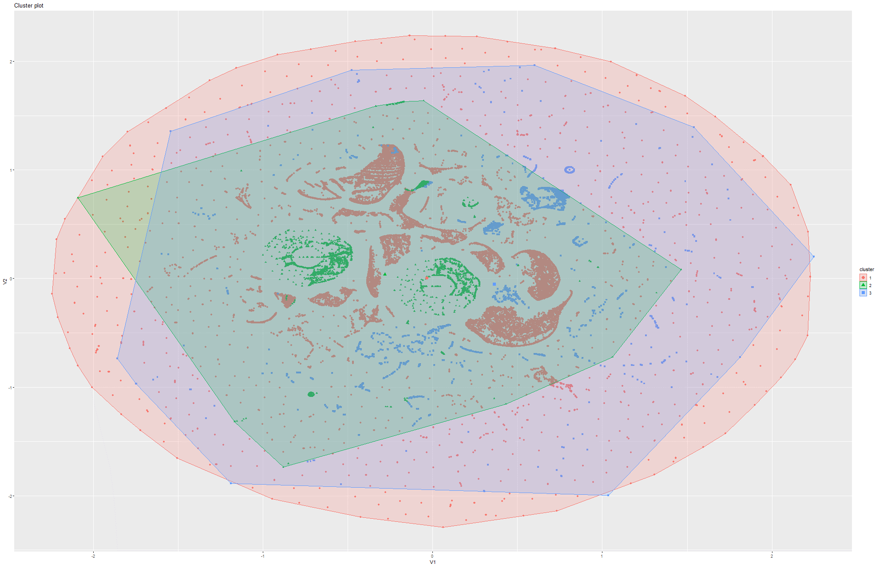
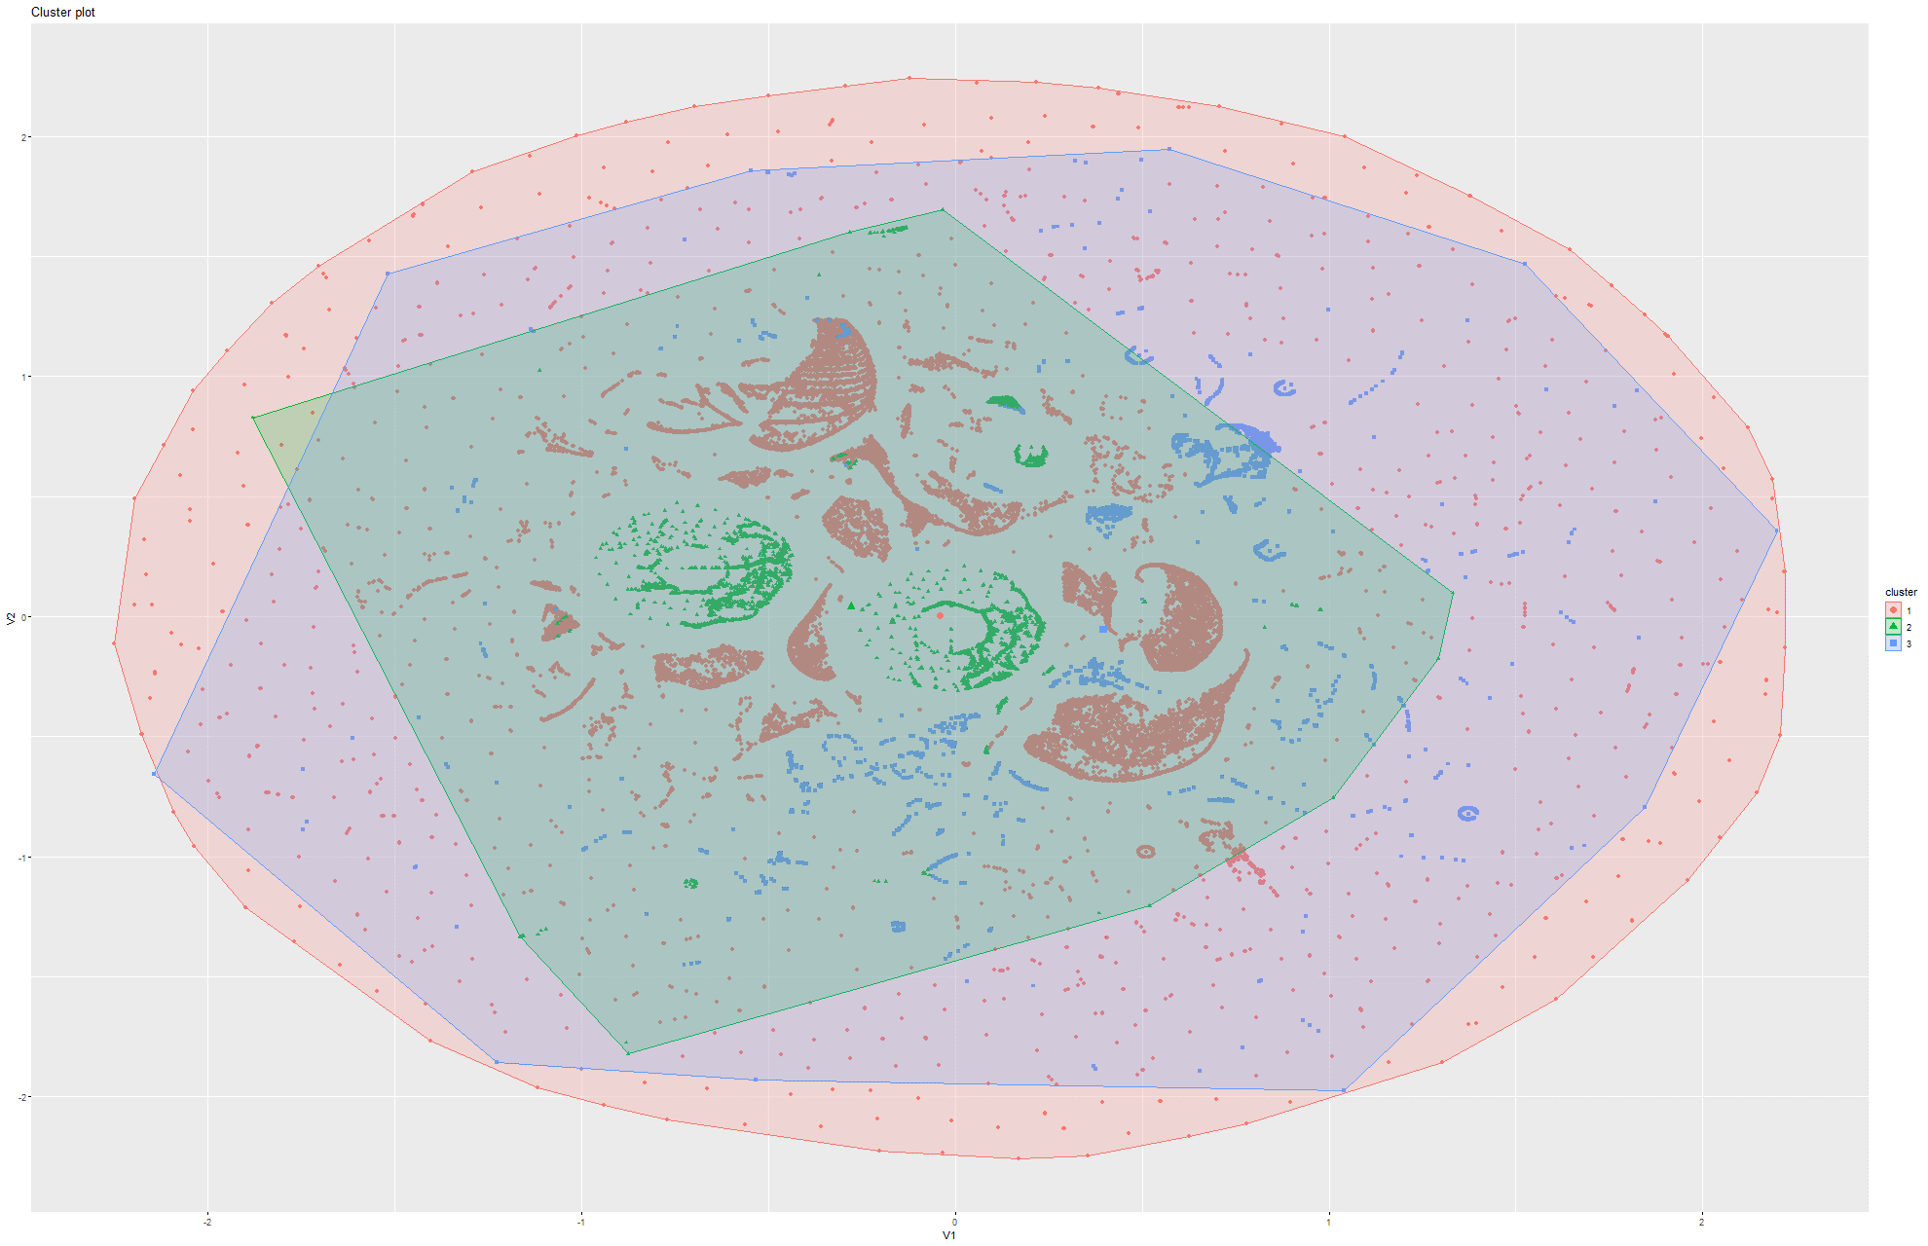
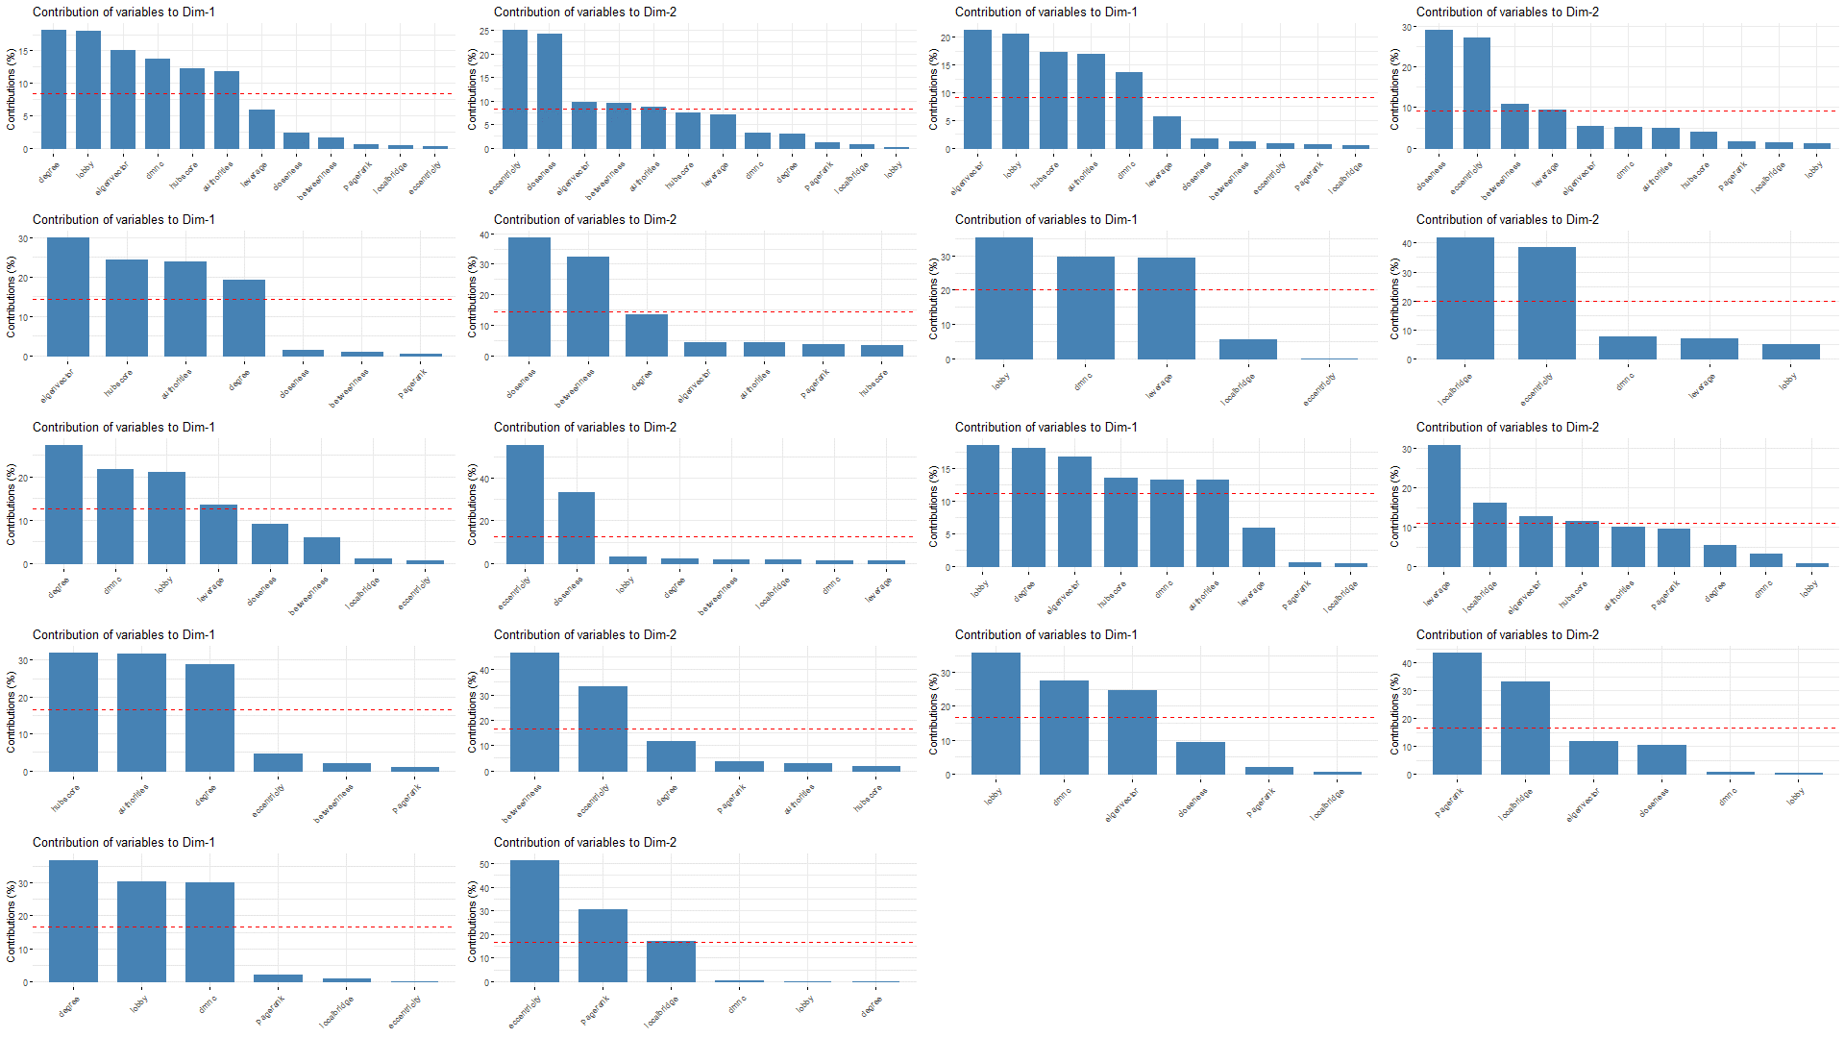
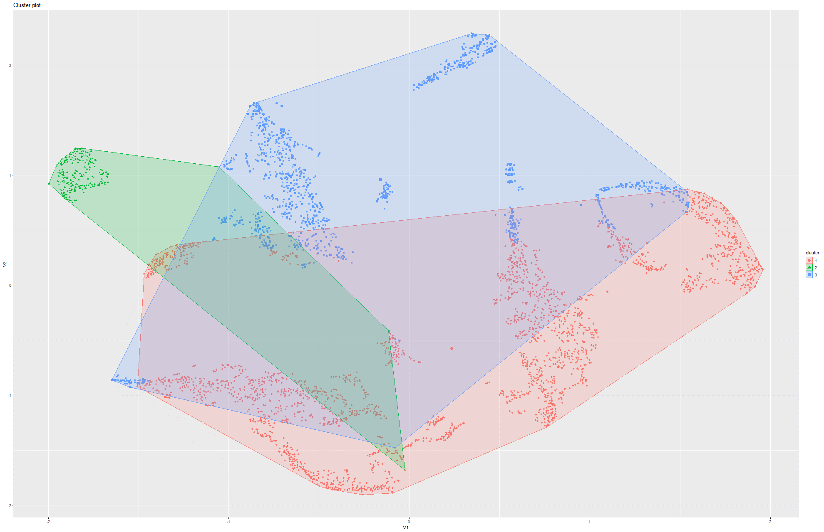
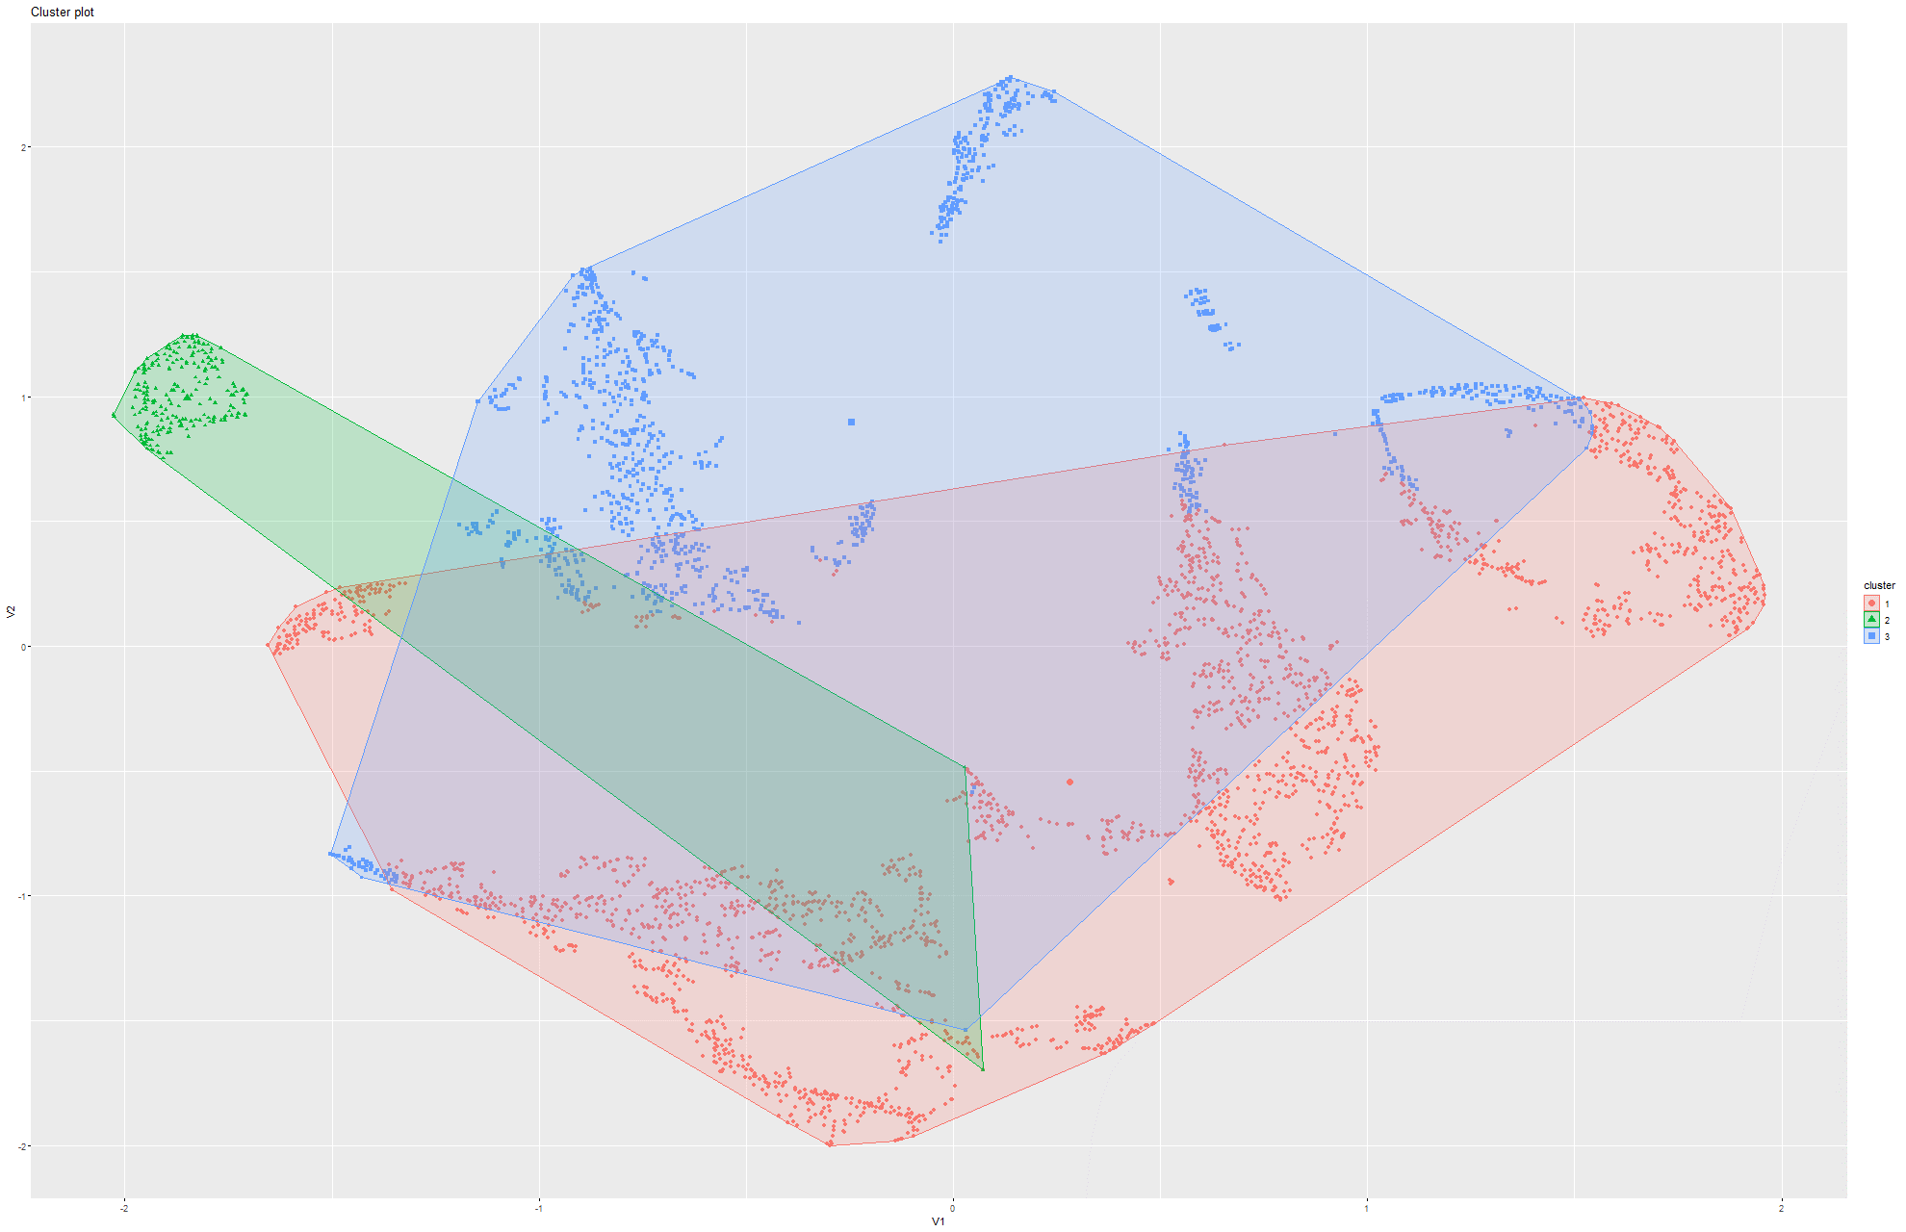
P2P Aug 4 Model 1
P2P Aug 4 Model 2
Finding 1:
Removing Degree from the centralities does NOT cause much of a change in structure. This is in contrast to our assumption and finding in PCA, which showed that Degree is usually the factor with the most variance
Eu-All Model 1
Eu-All Model 2
Facebook Ego Model 1
Facebook Ego Model 2

Slide 23
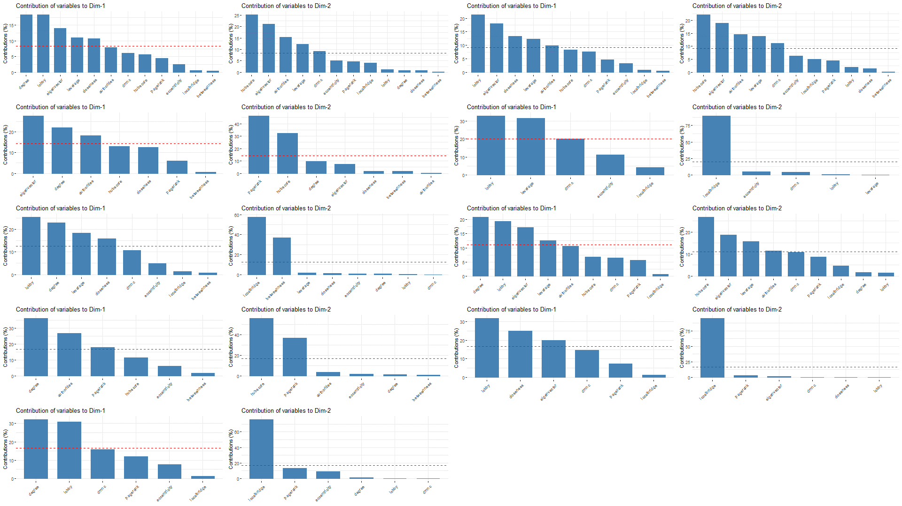
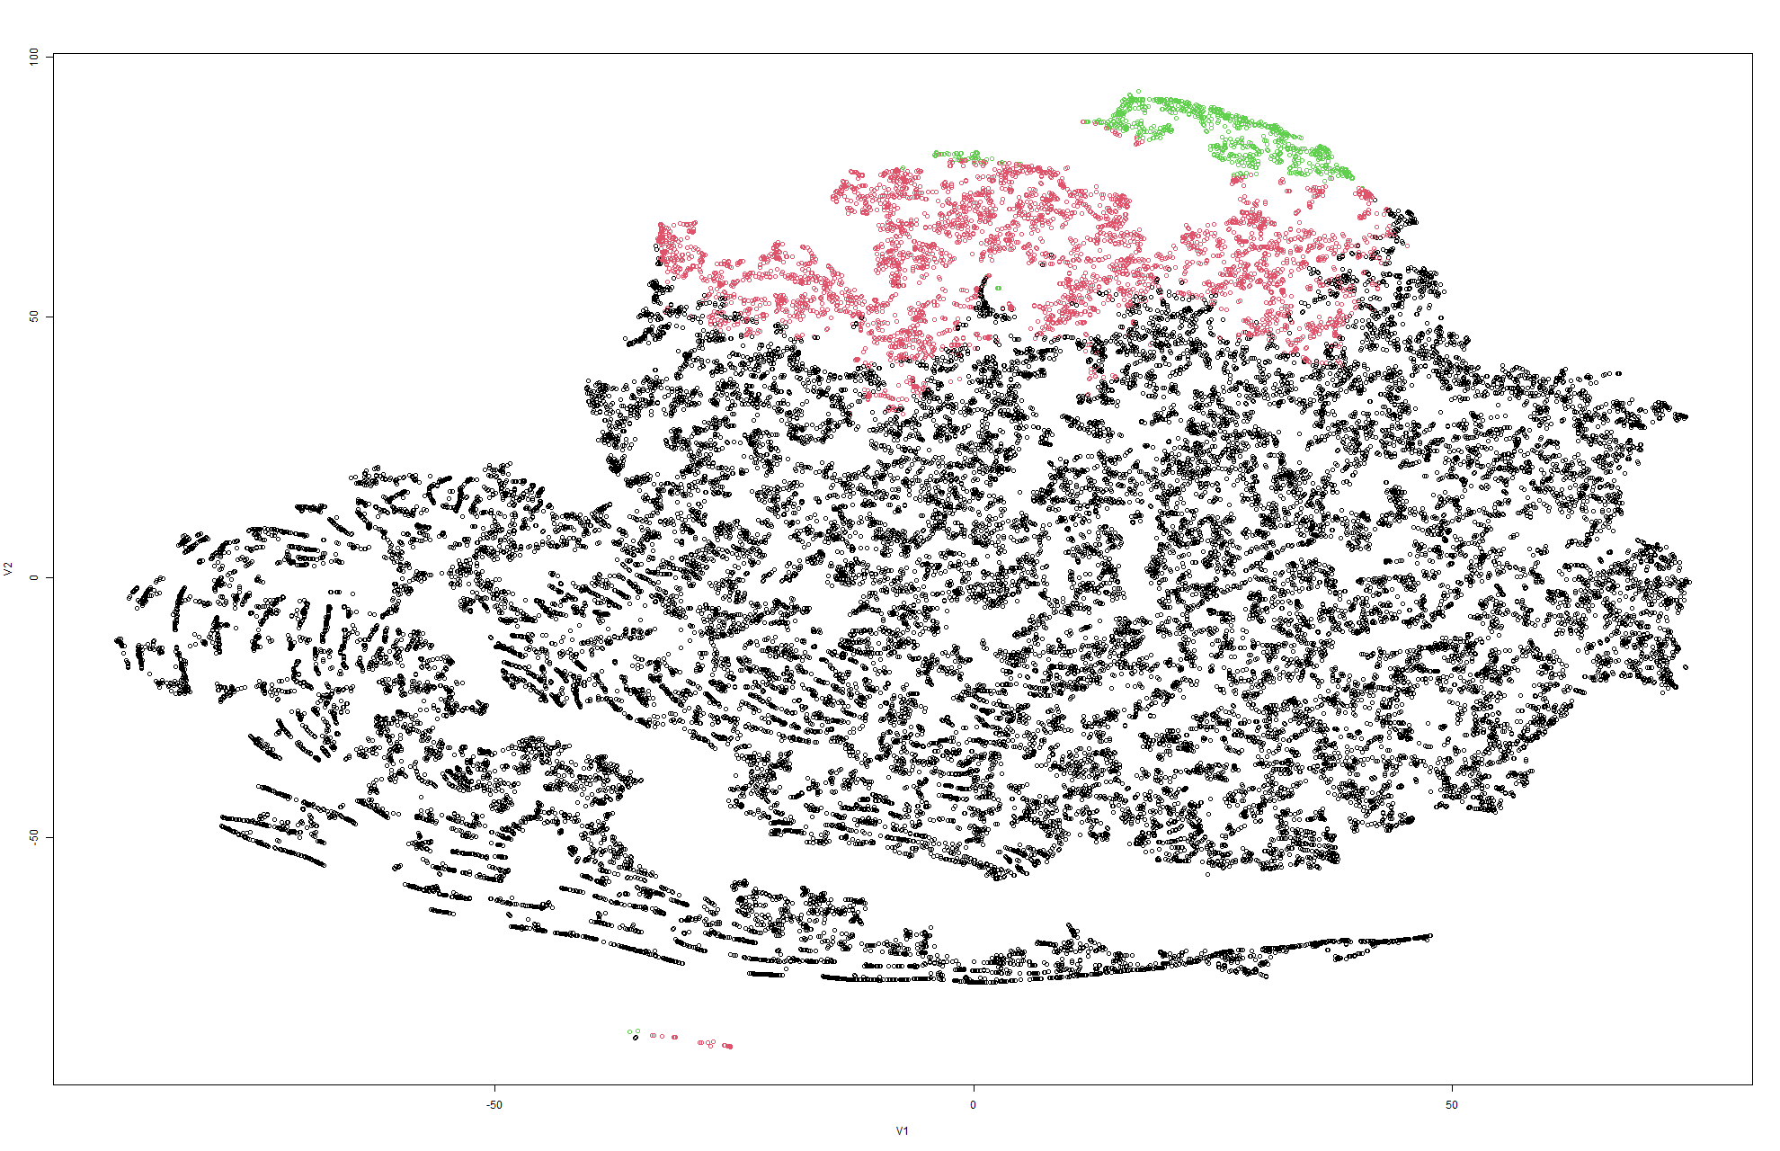
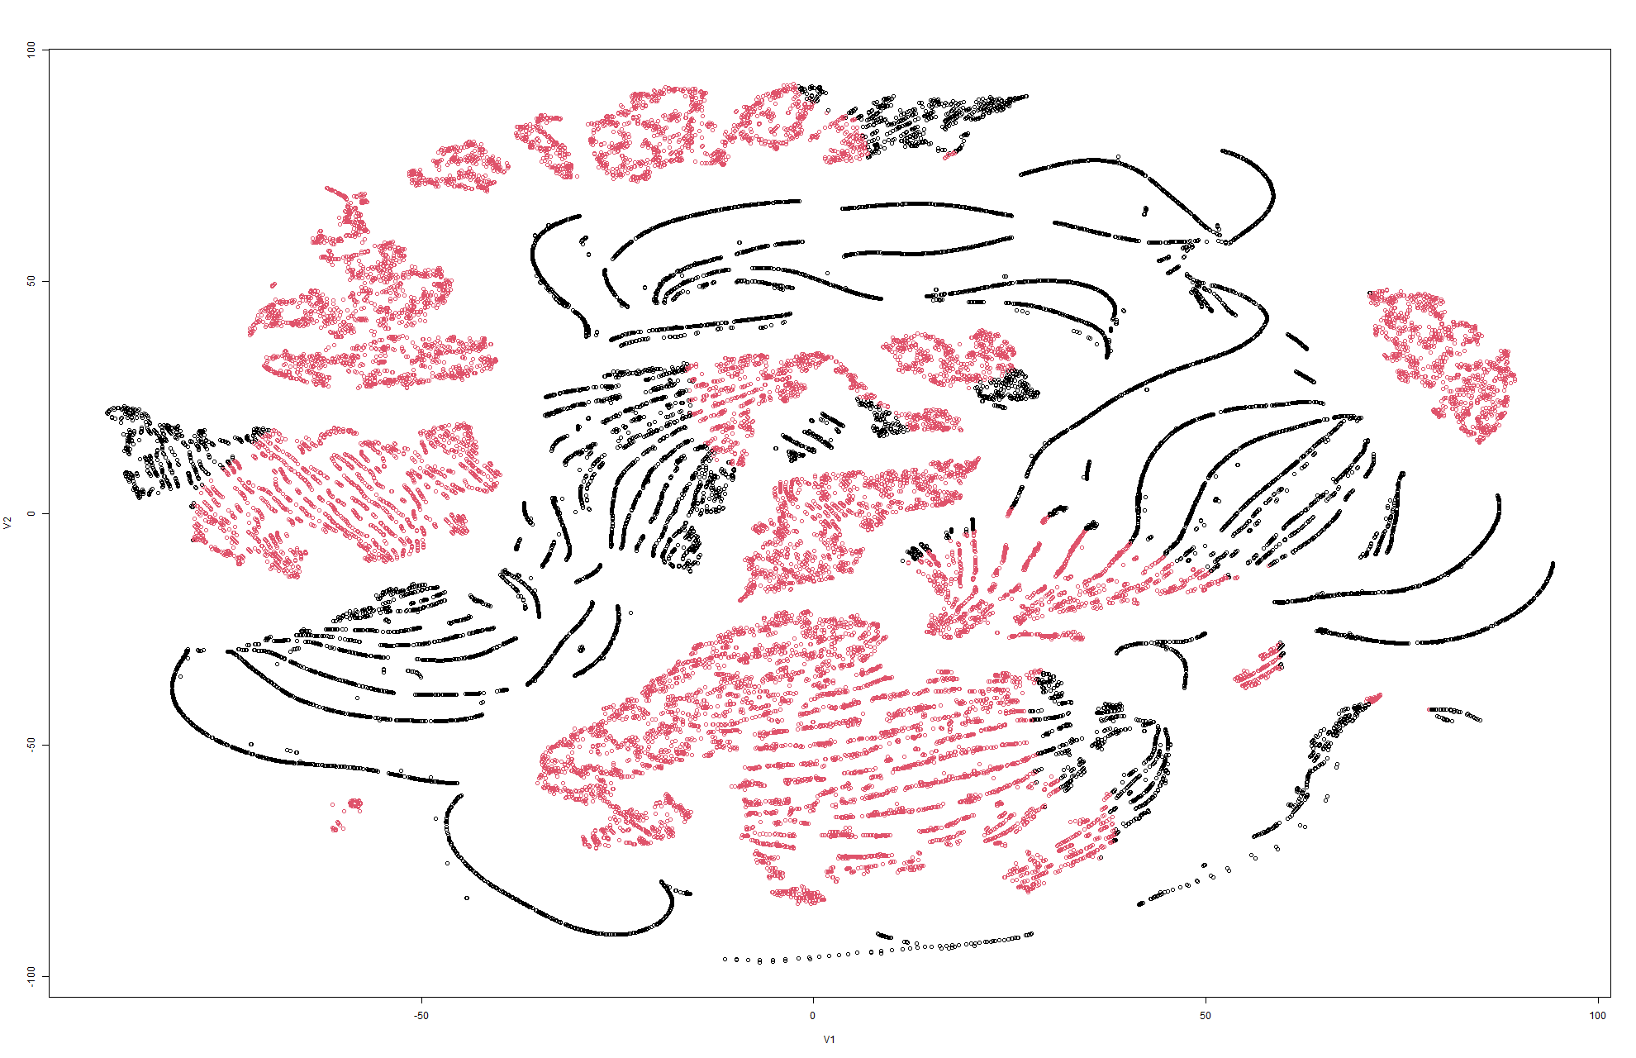
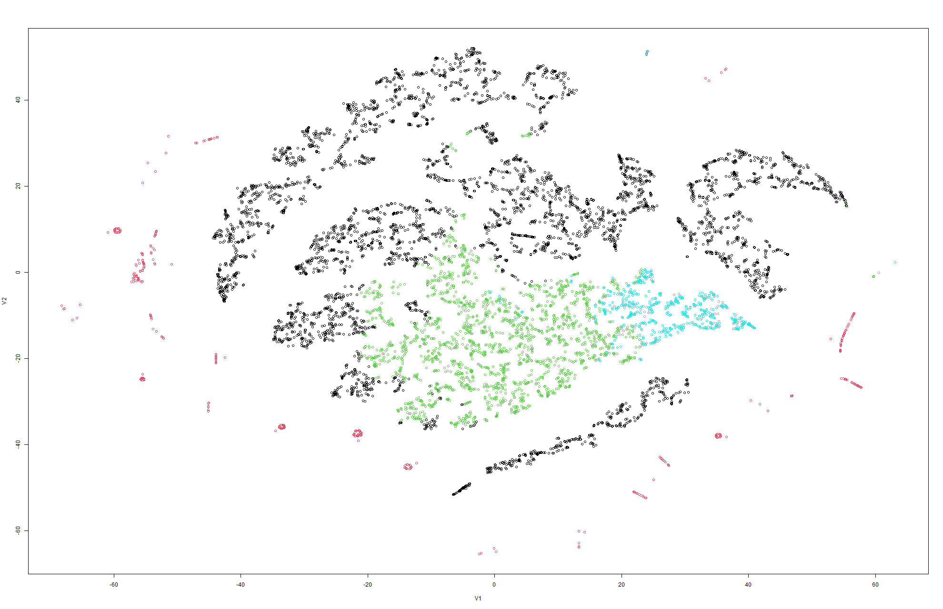
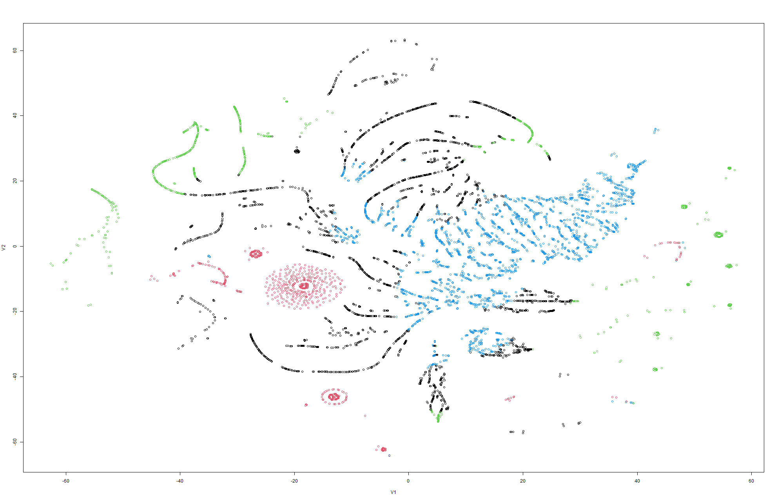
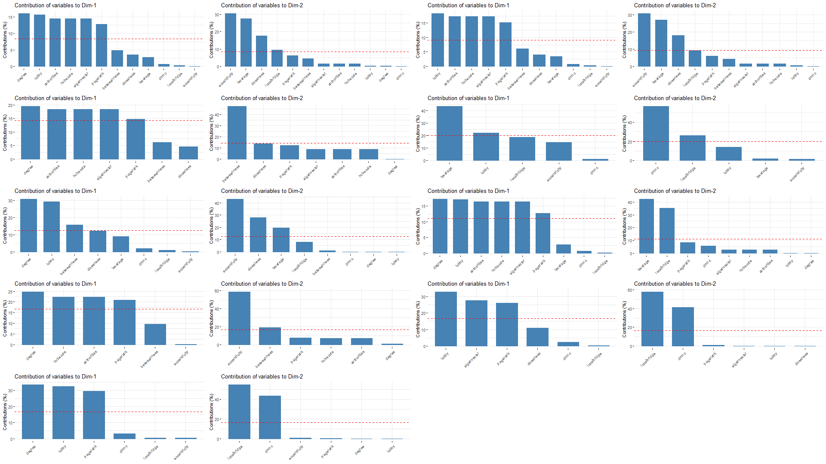
Finding 2:
Node centralities are responsible for the solid structures of the networks
Community centralities make a string-like structure in the network representation
High Energy physics citation Model 3
High Energy physics citation Model 4
High Energy Phy Theory Collaboration Model 3
High Energy Phy Theory Collaboration Model 4

Slide 24
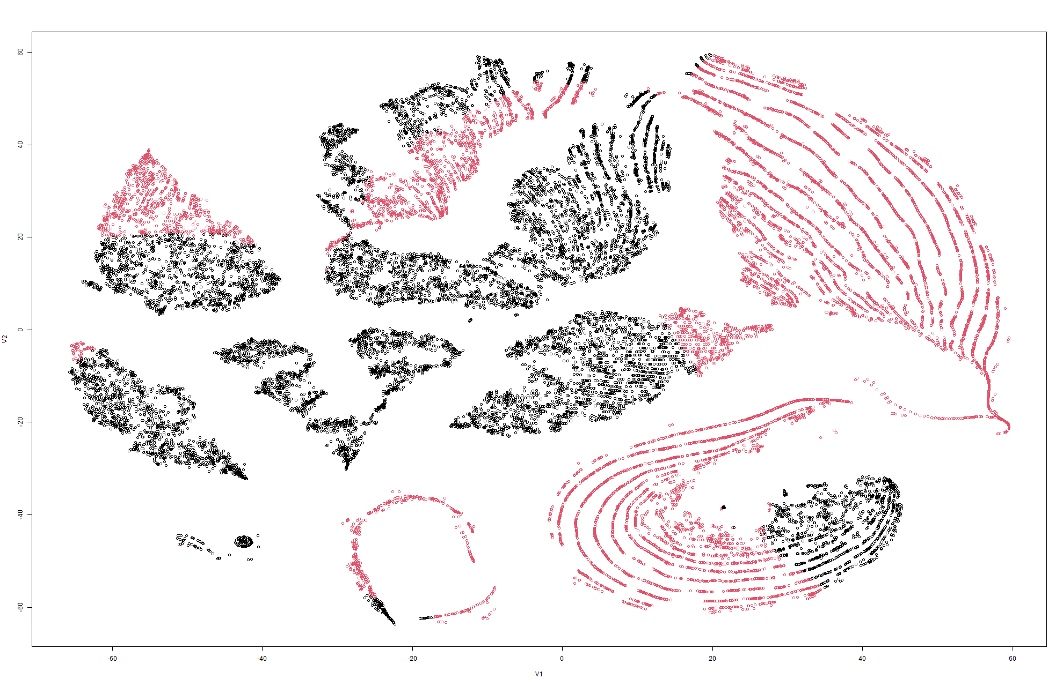
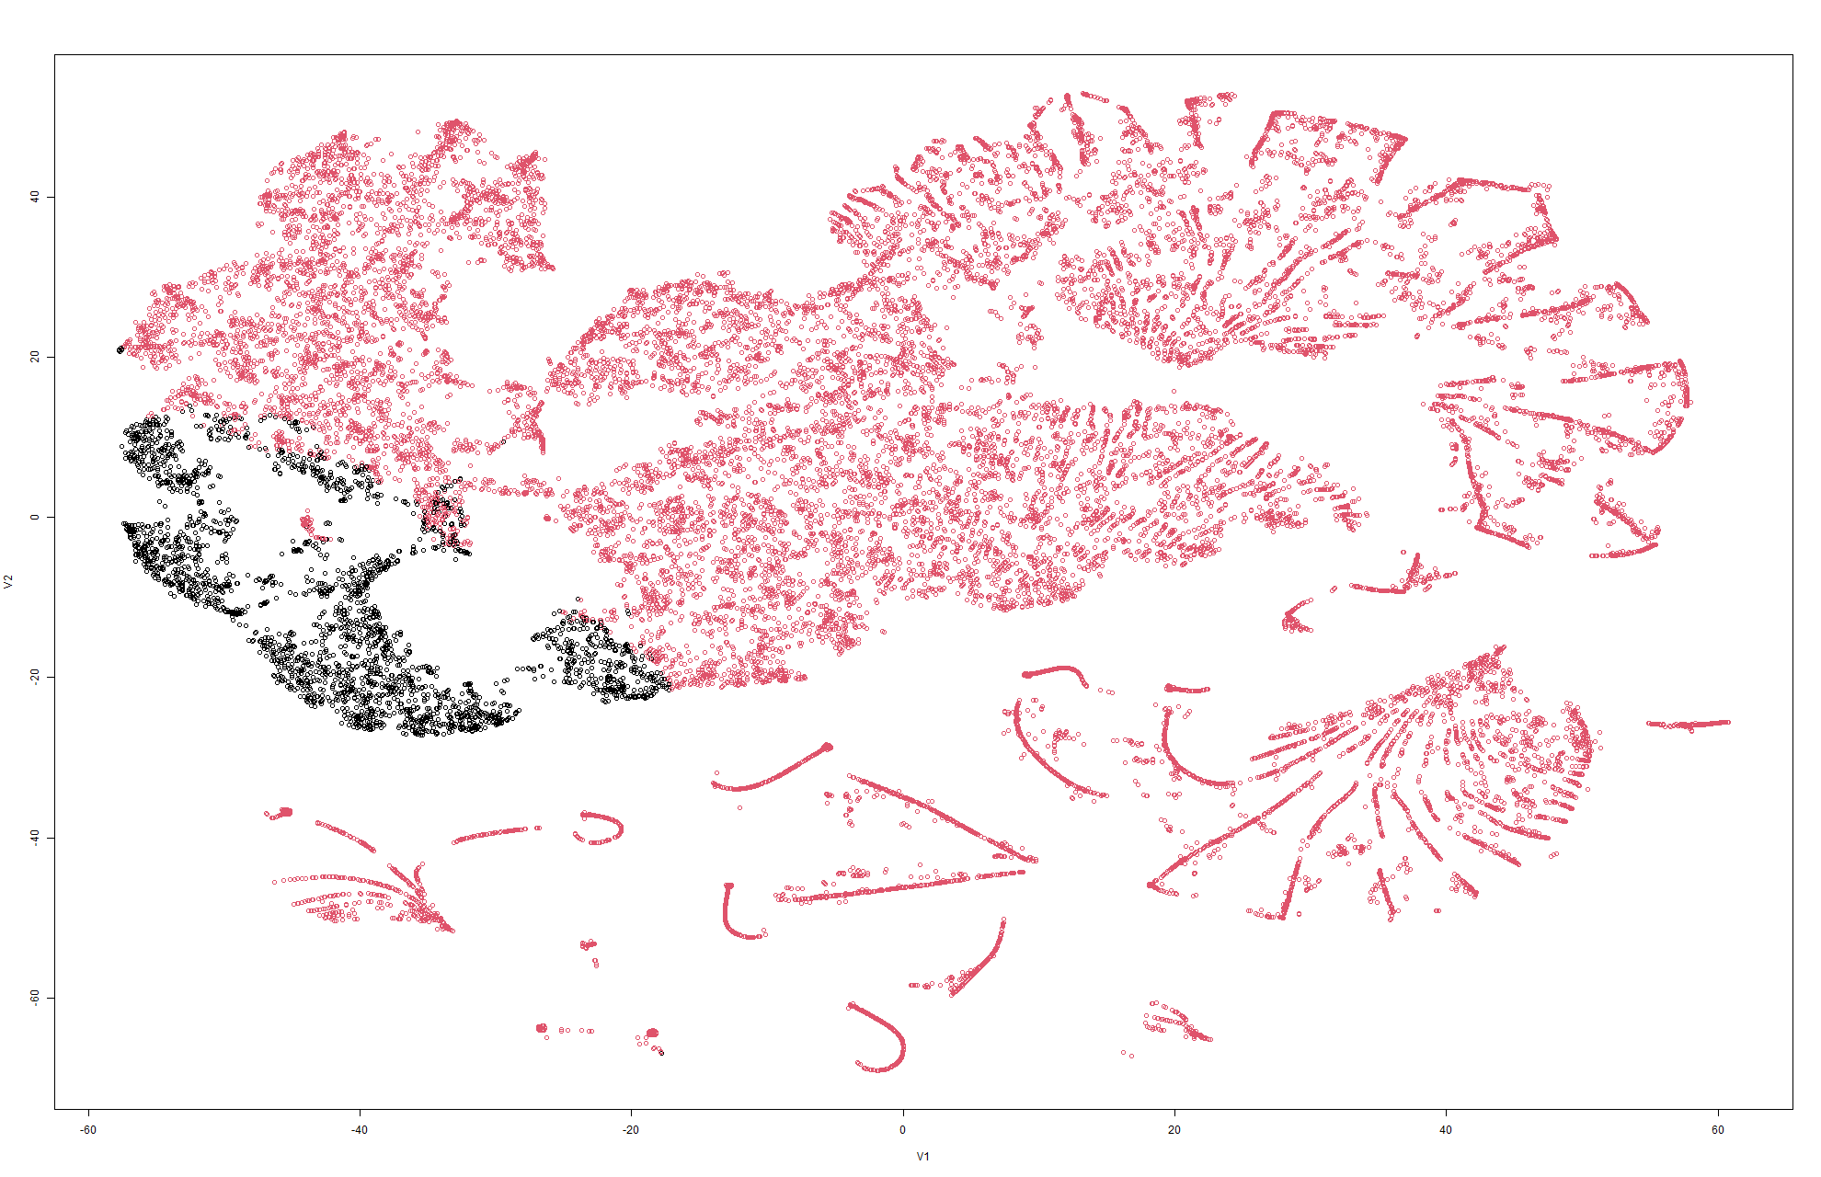
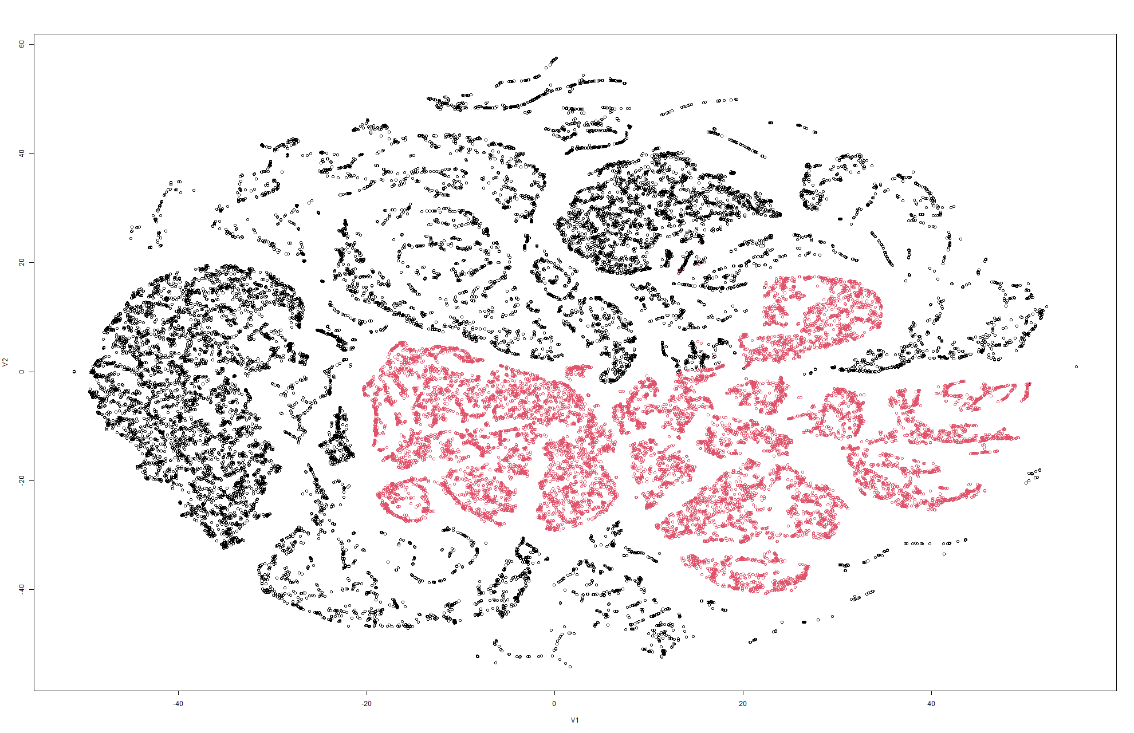
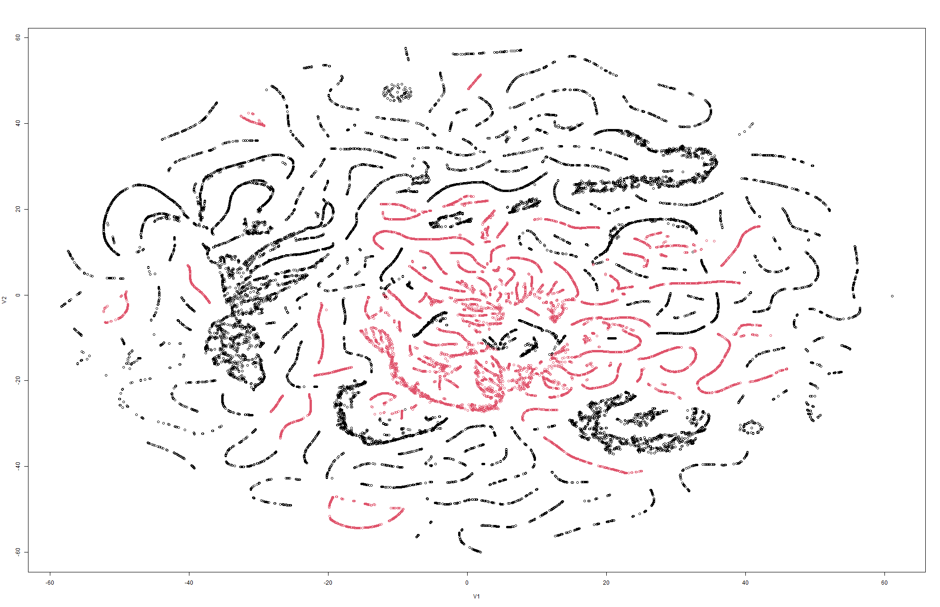
Finding 3: To understand which Community centrality was the main cause of the string-like structure, we noticed that Eccentricity seemed to play a crucial role
Eccentricity is present in both Model 4 and Model 7
Eccentricity is not present in Model 8 but is present in Model 9
High Energy Phy Theory Citation Model 4
High Energy Phy Theory Citation Model 7
P2P Aug 30 Model 8
P2P Aug 30 Model 9

Slide 25
Communication Hierarchy
Email communication has more clusters as mostly people working closely together communicate via email
Collaboration is a bit more spread out and sparse as often authors collaborate by minimal communication, and usually collaborate within a fixed set of people
Citation, on the other hand, is much denser as publications cite papers from many different domains
Eu-All
High Energy Physics Collaboration
High Energy Physics Citation

Slide 26
Network Hierarchical Relation
Eu-All
Communication
Enron
P2P
P2P-All
Citation
Collaboration
Social network
Ca-HepPH
Ca-HepTH
Cit-HepPH
Cit-HepTH
Ego-Facebook

Slide 27
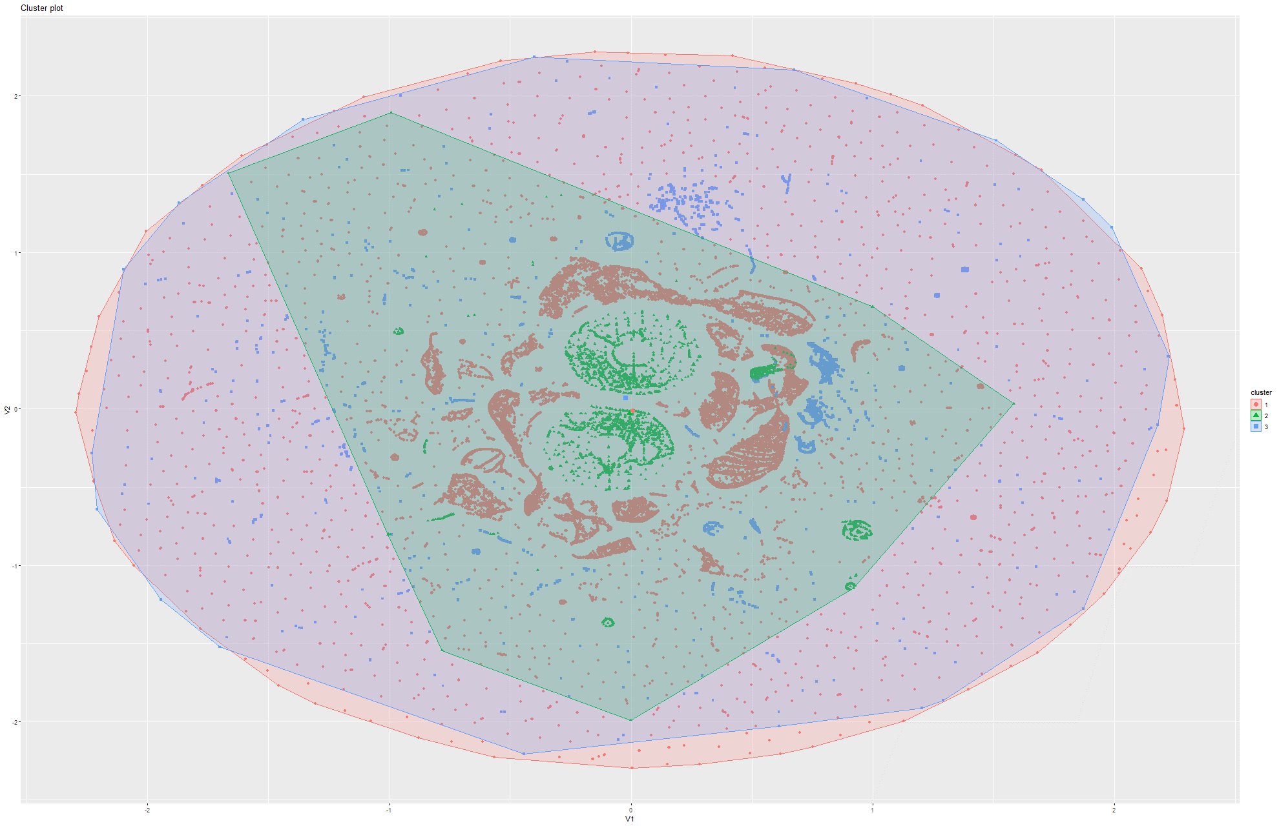
Galaxy Model of Communication

Slide 28
Conclusion
Networks have characteristic structures that stem from human behavior and traffic volume. These structures also have a hierarchichal relation
Community based centralities are good at finding characteristics such as communication
Node based centrality are more influential when it comes to structures whereas community centralities partially break down solid shapes.

Slide 29
[1] Department of Physics Department of Electrical and Computer Engineering. (2012). Review Literature And Arts Of The Americas, 3977–3980.
[2] Dwyer, T., Kosch, D., & Xu, K. (2003). Visual Analysis of Network Centralities. Wuchty 2002.
[3] De La Peña Sarracén, G. L., & Rosso, P. (2018). Automatic text summarization based on betweenness centrality. ACM International Conference Proceeding Series, Part F1377. https://doi.org/10.1145/3230599.3230611
[4] Wu, Q., Qi, X., Fuller, E., & Zhang, C. Q. (2013). “follow the leader”: A centrality guided clustering and its application to social network analysis. The Scientific World Journal, 2013. https://doi.org/10.1155/2013/368568
[5] Huang, X., Zhao, Y., Yang, J., Zhang, C., & Ye, X. (2016). TrajGraph : A Graph-Based Visual Analytics Approach to Studying Urban Network Centralities Using Taxi Trajectory Data. 22(1), 160–169.
[6] Crucitti, P., Latora, V., & Porta, S. (2006). Centrality measures in spatial networks of urban streets. Physical Review E - Statistical, Nonlinear, and Soft Matter Physics, 73(3), 1–5. https://doi.org/10.1103/PhysRevE.73.036125
[7] Zhang, Y., Wang, X., Zeng, P., & Chen, X. (2011). Centrality characteristics of road network patterns of traffic analysis zones. Transportation Research Record, 2256, 16–24. https://doi.org/10.3141/2256-03

